Slide 1
PARKS ON THE AIR
KC7TAK & W7TEE
Ryan Poteet Maria Garofoli

Slide 2
What is Parks On The Air or POTA?
History
POTA Website and app
Hunter
Activator
Field Deployment
Equipment Considerations
Creature Comforts
Spotting
Logging Process
Public Relations
Awards
POTA Yearly Events
Advanced Topics

Slide 3
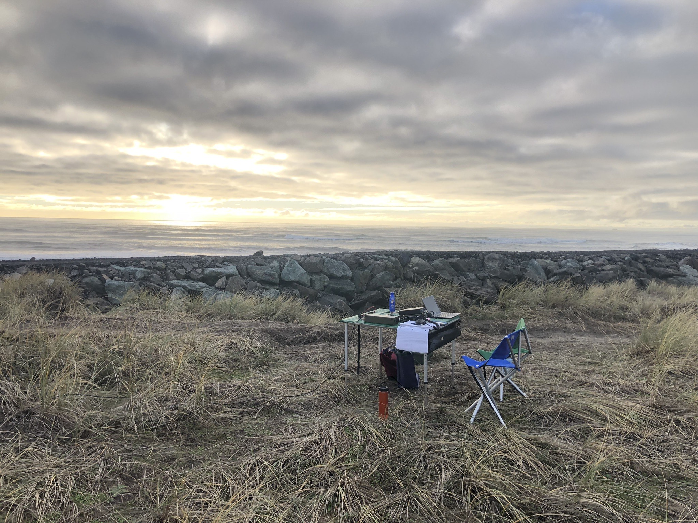

Slide 4
What is Parks On The Air or POTA?
It is not a contest.
An opportunity to practice your radio skills in a different environment.
Field Day everyday!
Operate away from RF noise and HOA restrictions.
Being the station that everyone wants to contact.
Practice handing pileups and passing information.
Enjoying nature and radio at the same time.
A chance to bring amateur radio into the public and display our capabilities.
Most importantly it’s FUN!

Slide 5
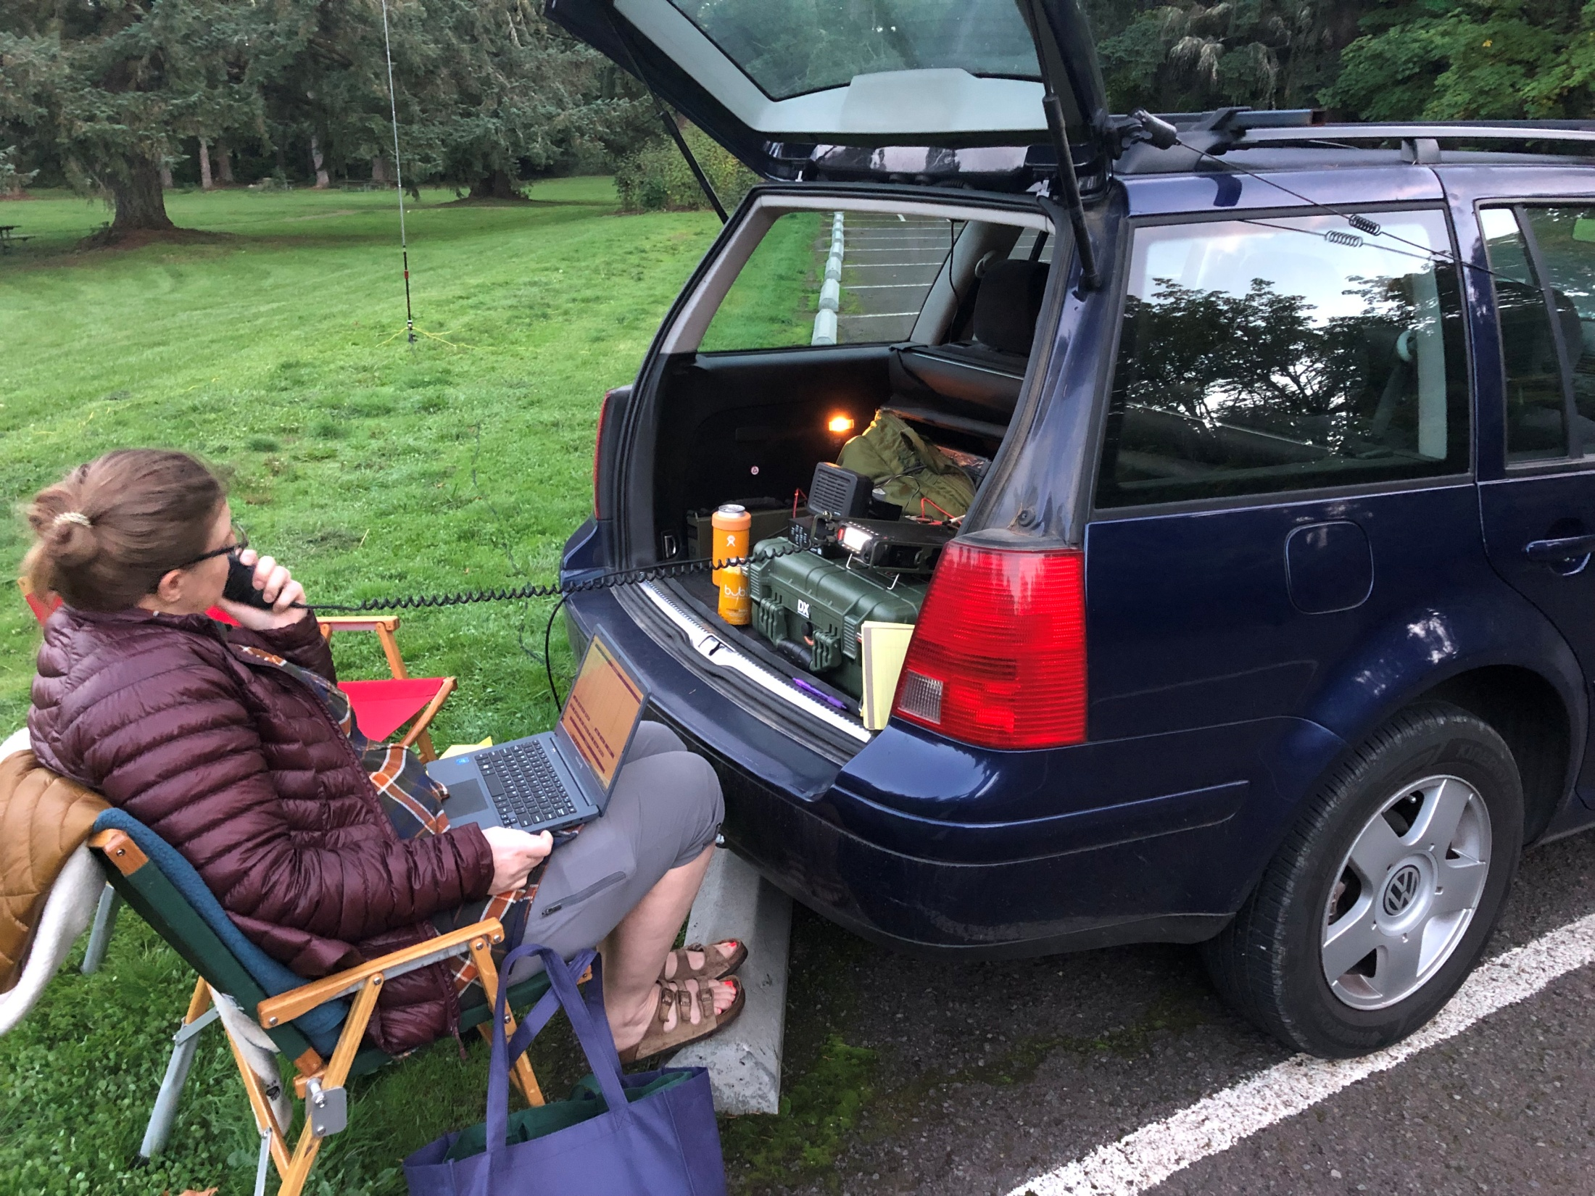

Slide 6
History
In 2010 the original Parks On The Air began. The intent was to get folks outdoors and to combine the great outdoors with our amateur radio hobby.
In 2016 the ARRL launched a one year program called NPOTA to celebrate the 100th anniversary of the National Park system.
This event was very popular and many wanted it to continue.

Slide 7
History
In 2018 a group formally launched a non profit organization to keep Parks on the Air going.
Now only 6 years later it’s grown to be a very popular past time world wide.
More than 11,000 parks in the USA are included in this program.
In Oregon we currently have 343 parks to visit.
Clackamas County currently has ~18 parks.

Slide 8
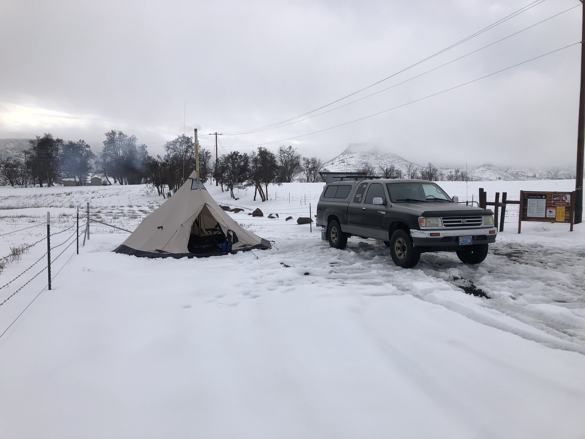

Slide 9
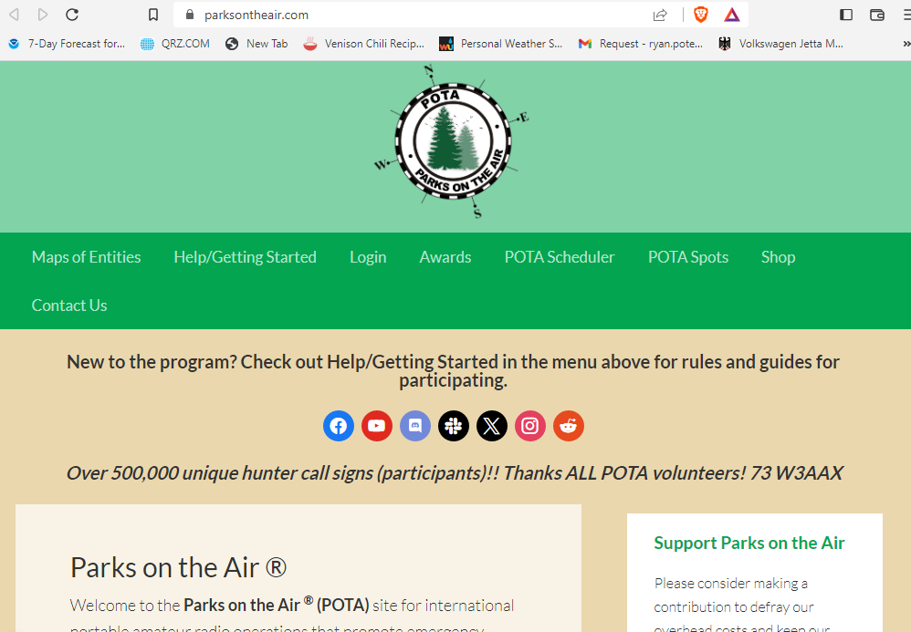

Slide 10
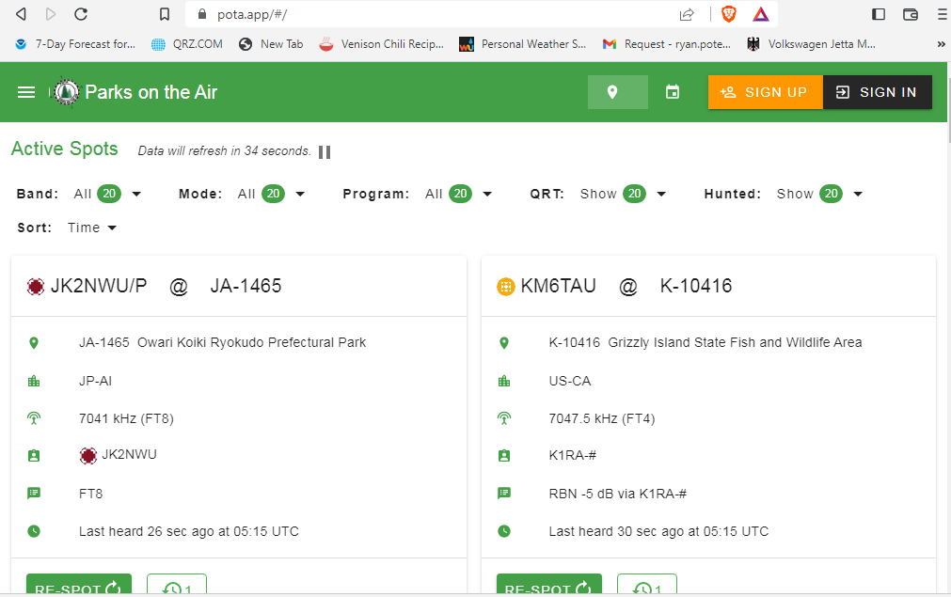
POTA APP and Website
https://pota.app/#/ parksontheair.com

Slide 11
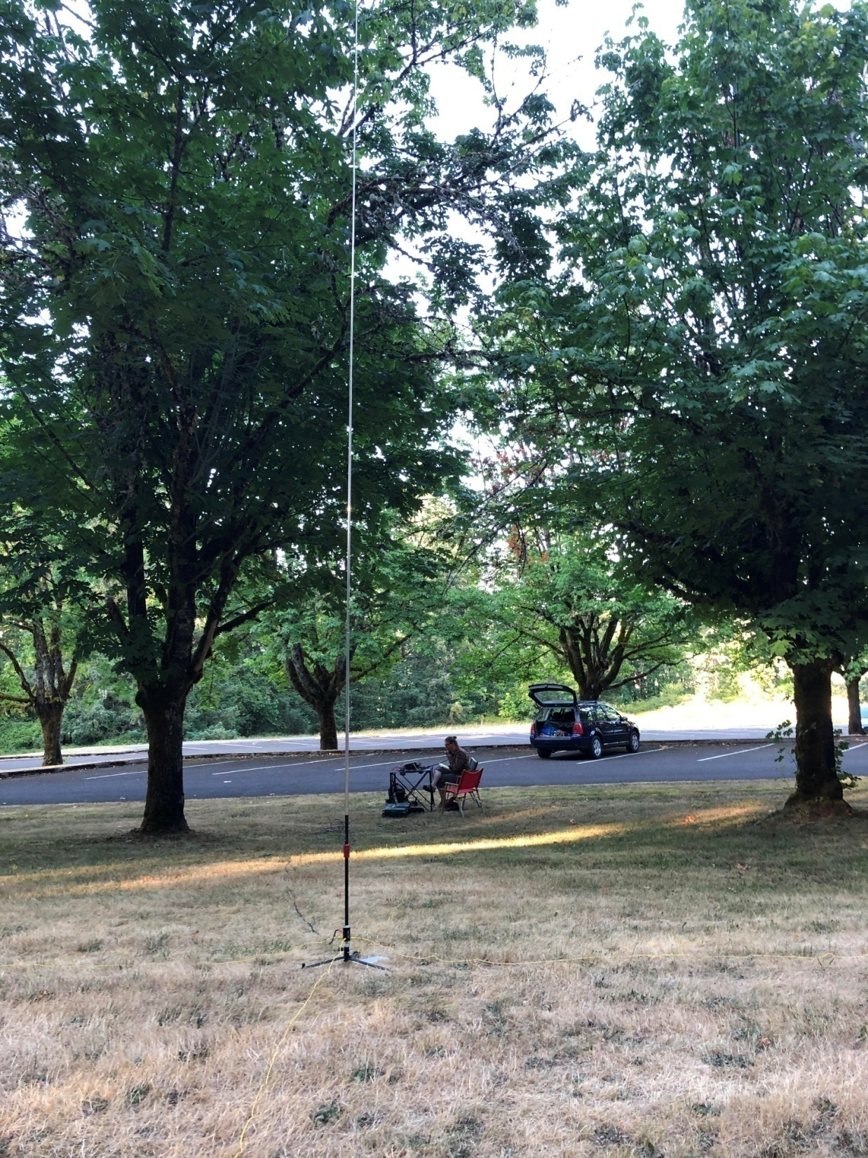

Slide 12
Hunter
You can hunt all hours of the day and from the comfort of your home QTH.
Logging is not a requirement for hunters.
Without hunters there would be far less stations to contact.
You can earn awards for hunting.

Slide 13
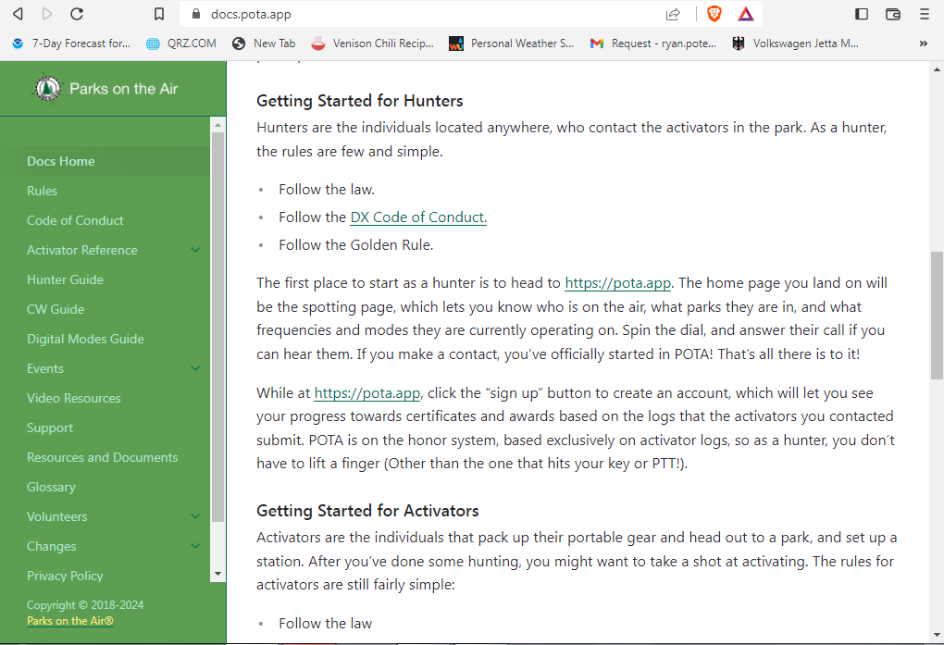

Slide 14
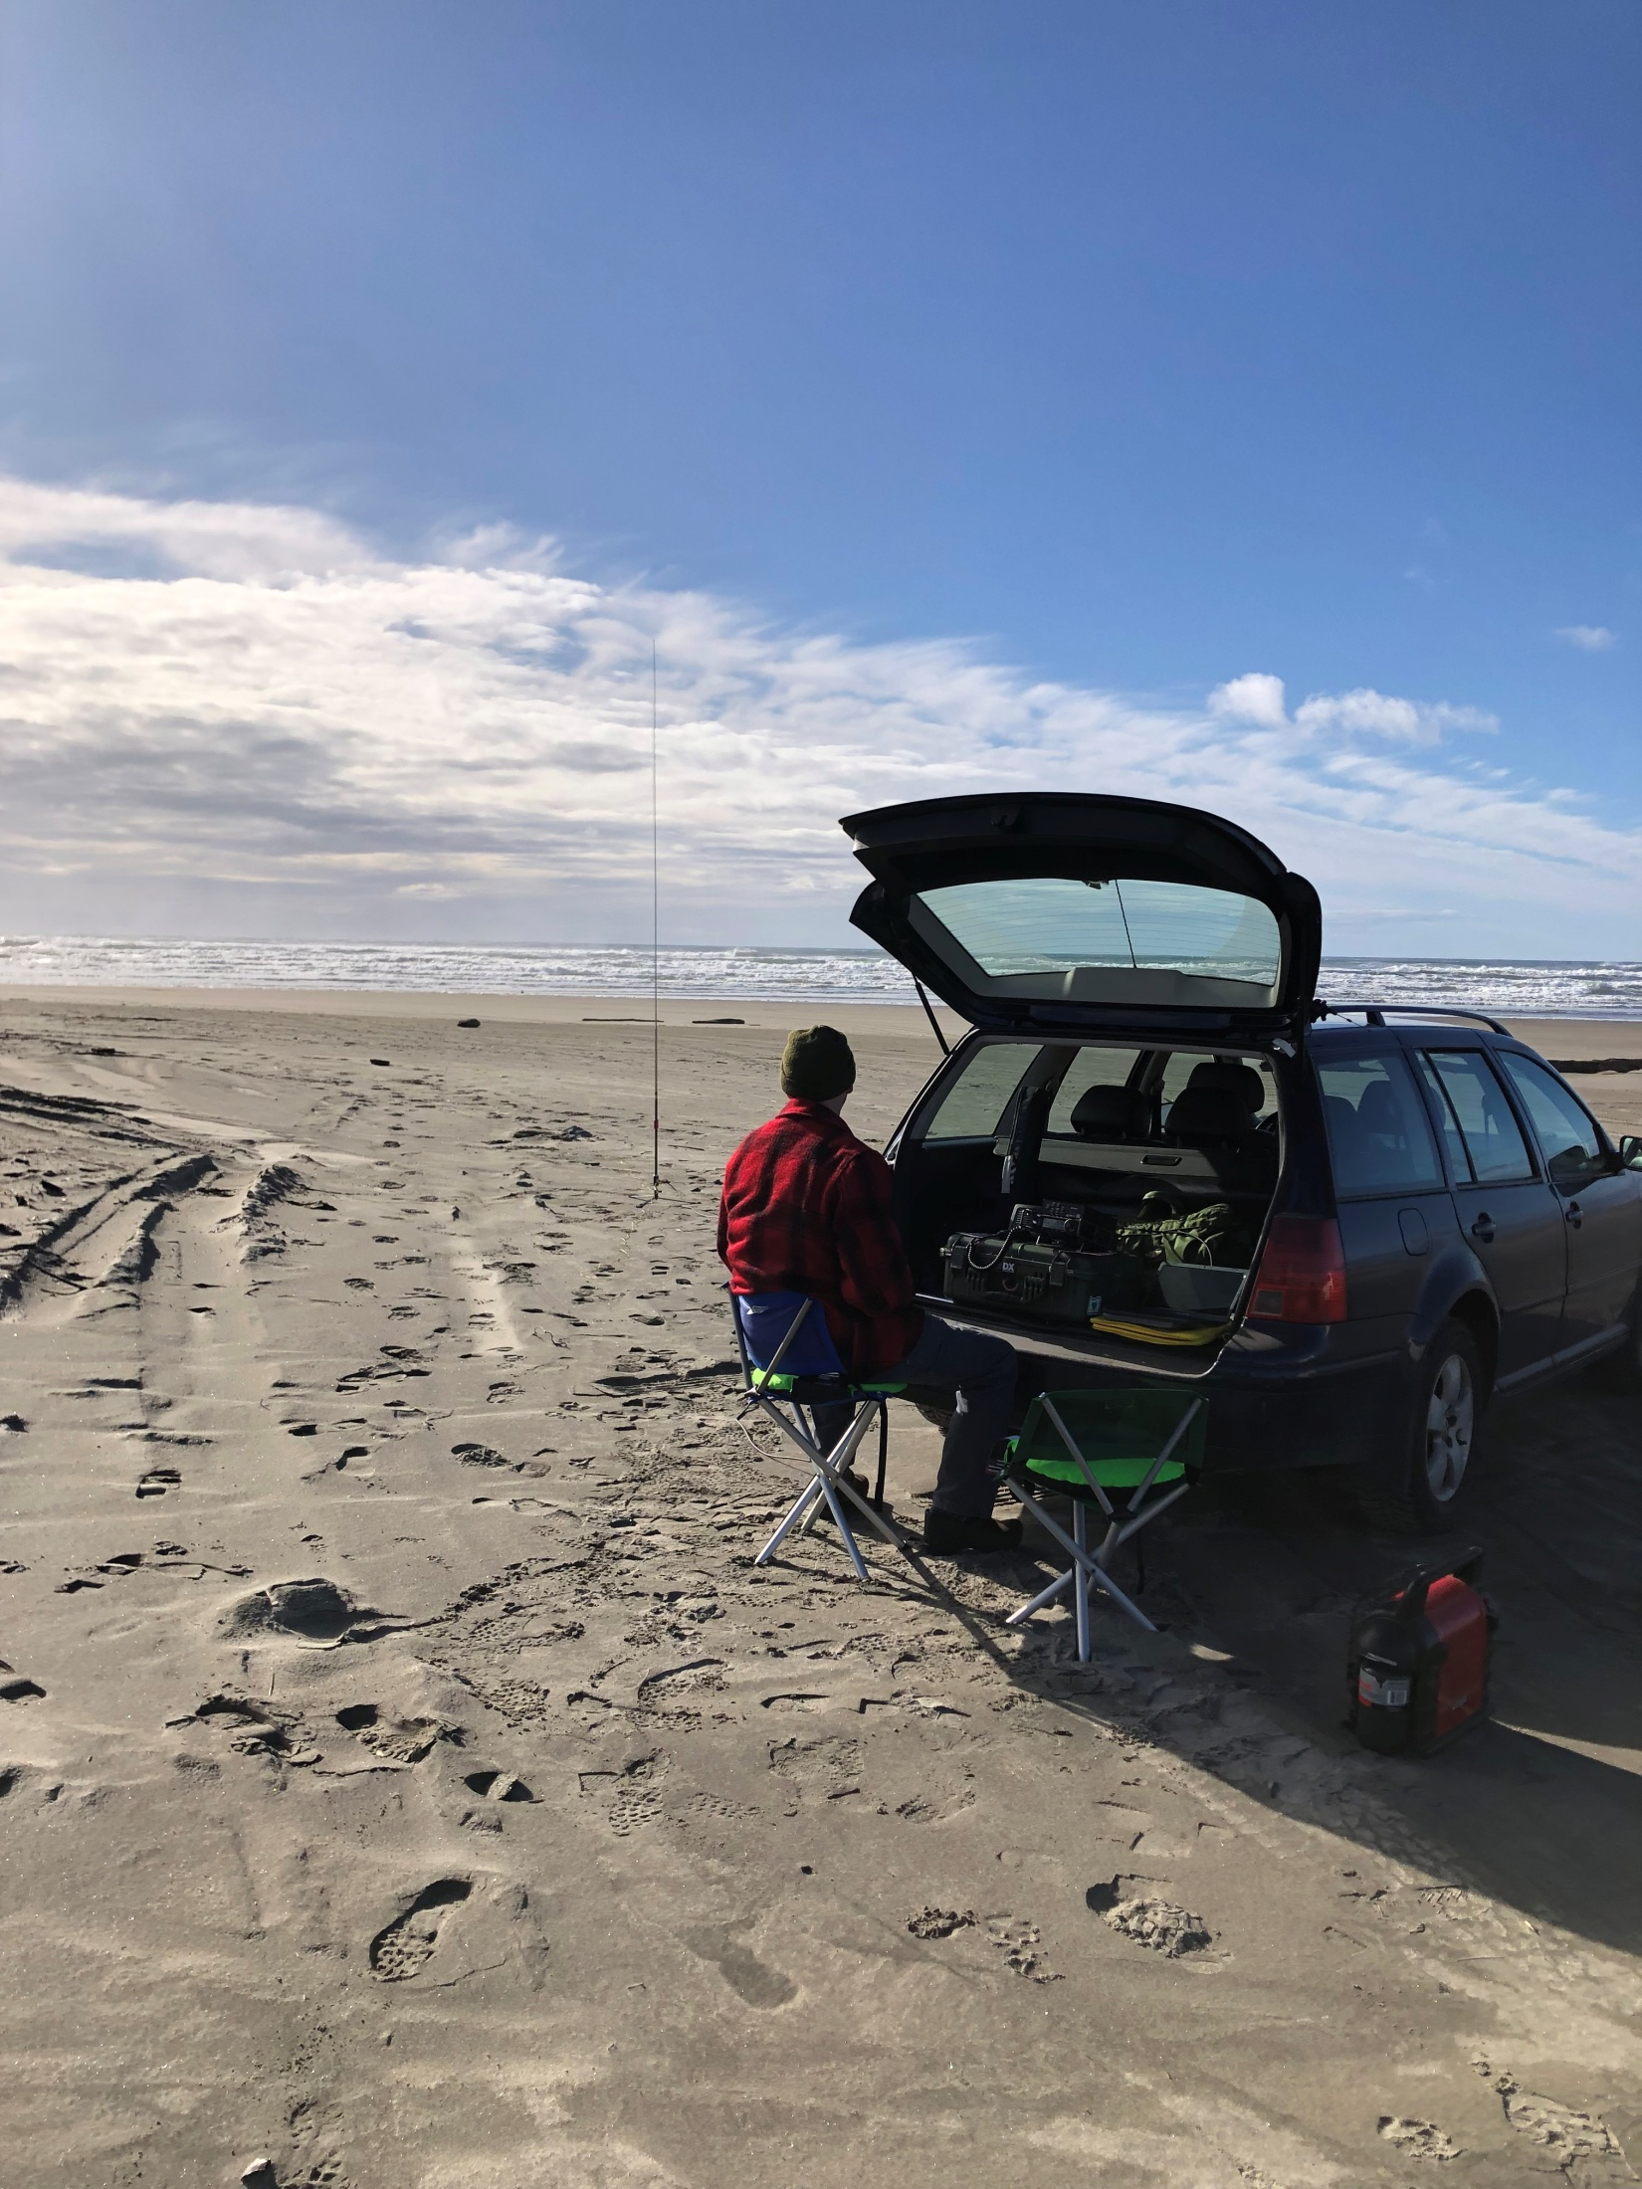

Slide 15
Activator
Activating takes some planning.
It’s your event, you run the activation however works best for you.
Logging the contacts is your responsibility.
10 contacts are required to have a “successful activation”.
You can earn awards for activating.

Slide 16
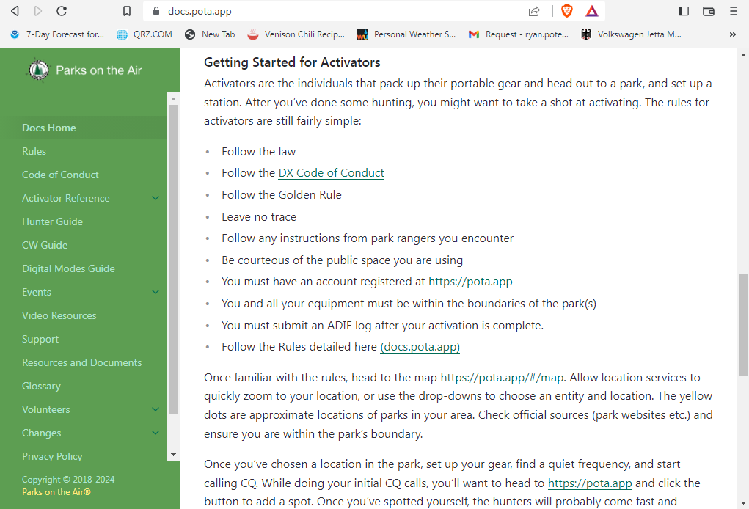

Slide 17
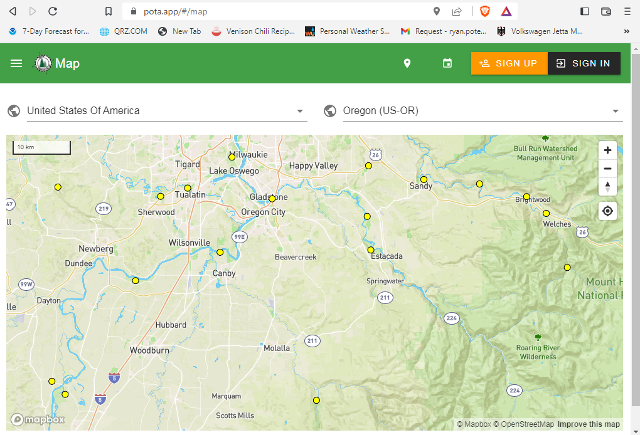

Slide 18
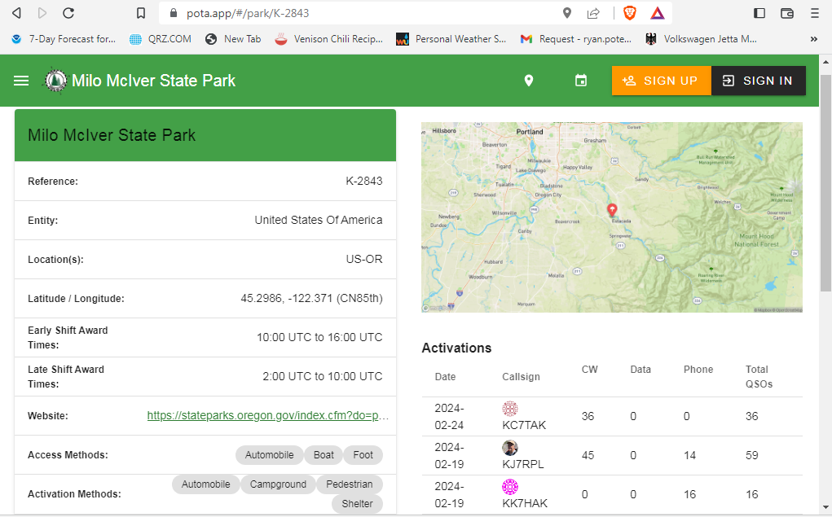

Slide 19
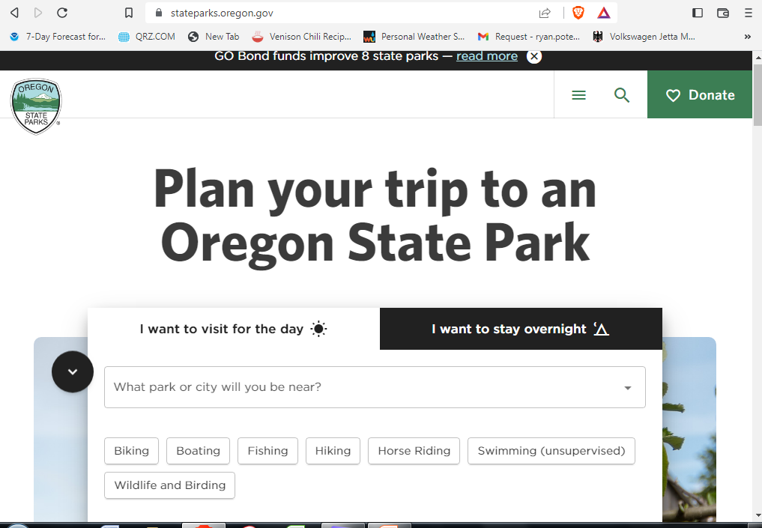

Slide 20
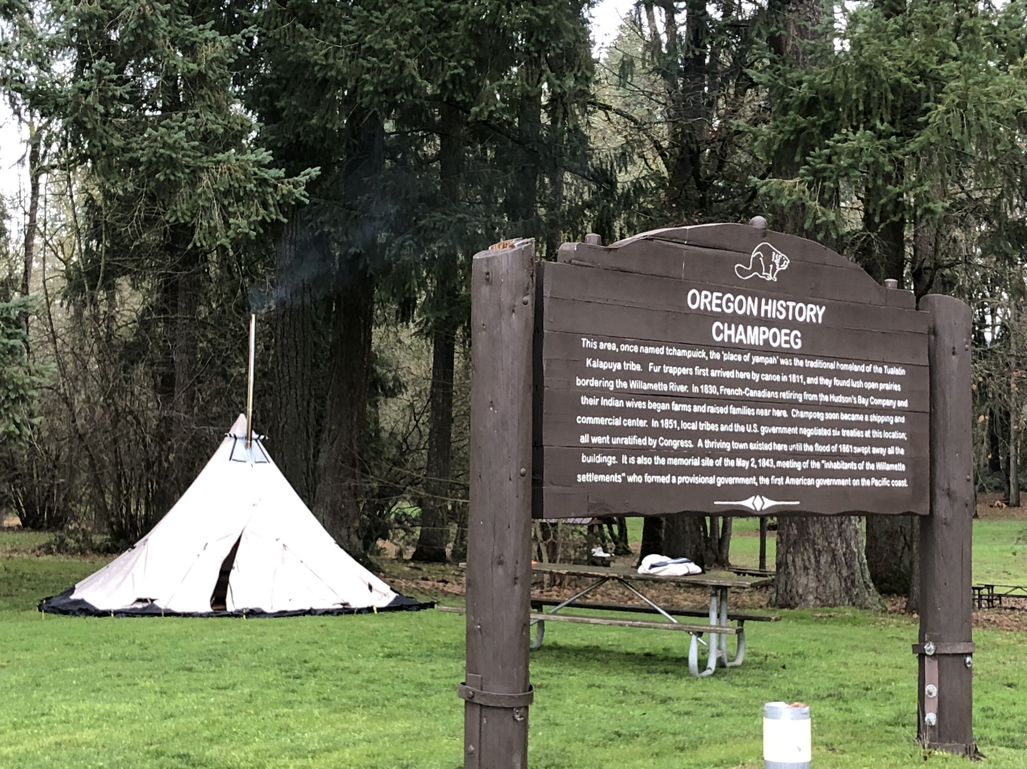

Slide 21
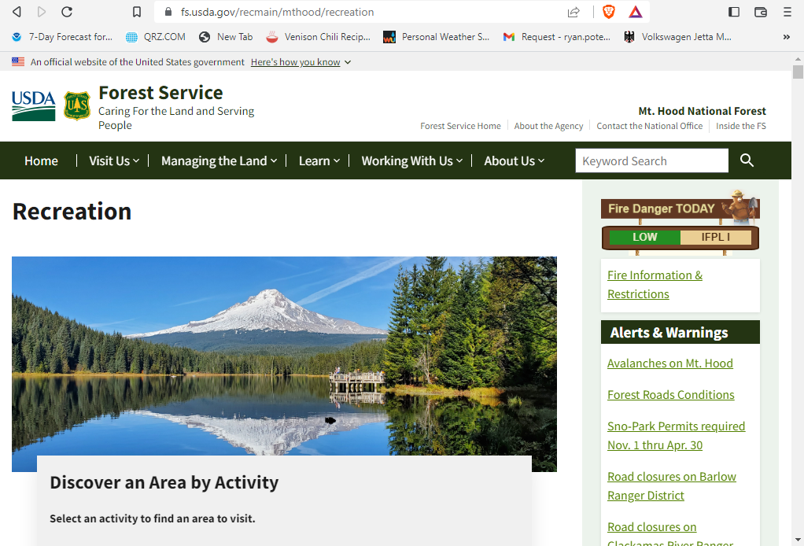

Slide 22
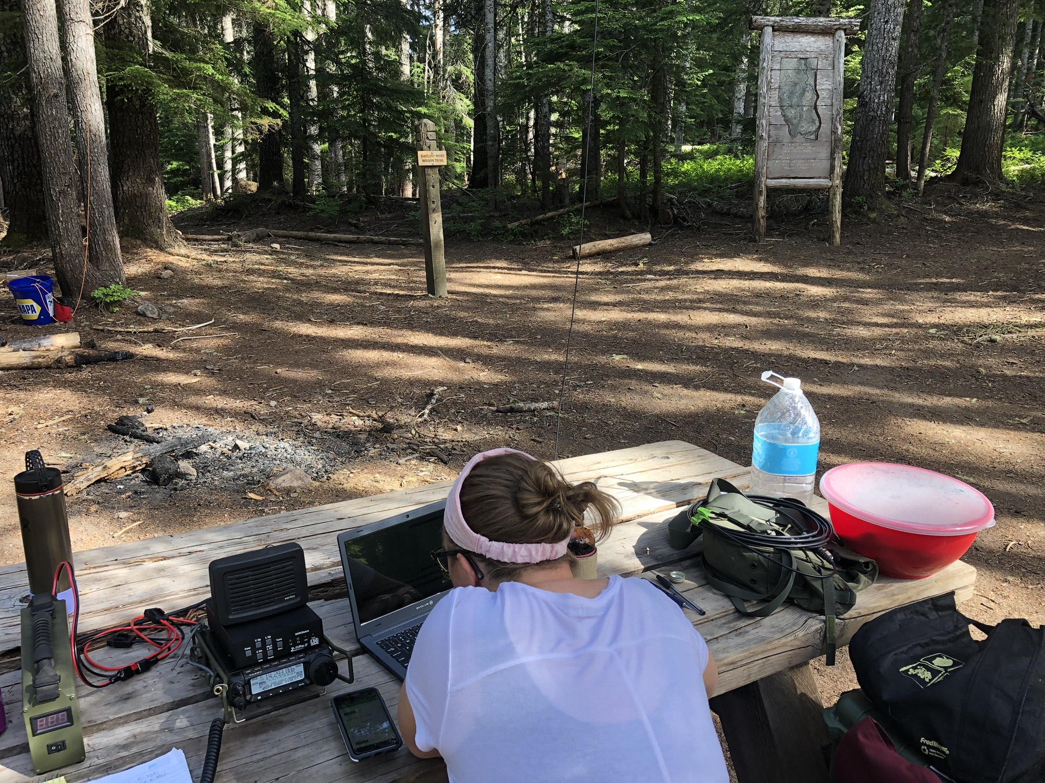

Slide 23
Field Deployment
Always check for park or pass requirements.
Oregon State Park fees and yearly passes. Day use $5 Yearly $30. USFS – NW Forest Pass, snow park, etc.
Check park hours and restrictions.
Where do you set up at the park?
Out of the way of other park visitors. Share the space that we all own and love.
Find a nice spot in the shade or with the best view.
The park ranger has the final say.
Historic sites may prevent driving stakes in the ground or attaching antennas to trees.
Dogs and small children may be curious so be prepared if they stop by.

Slide 24
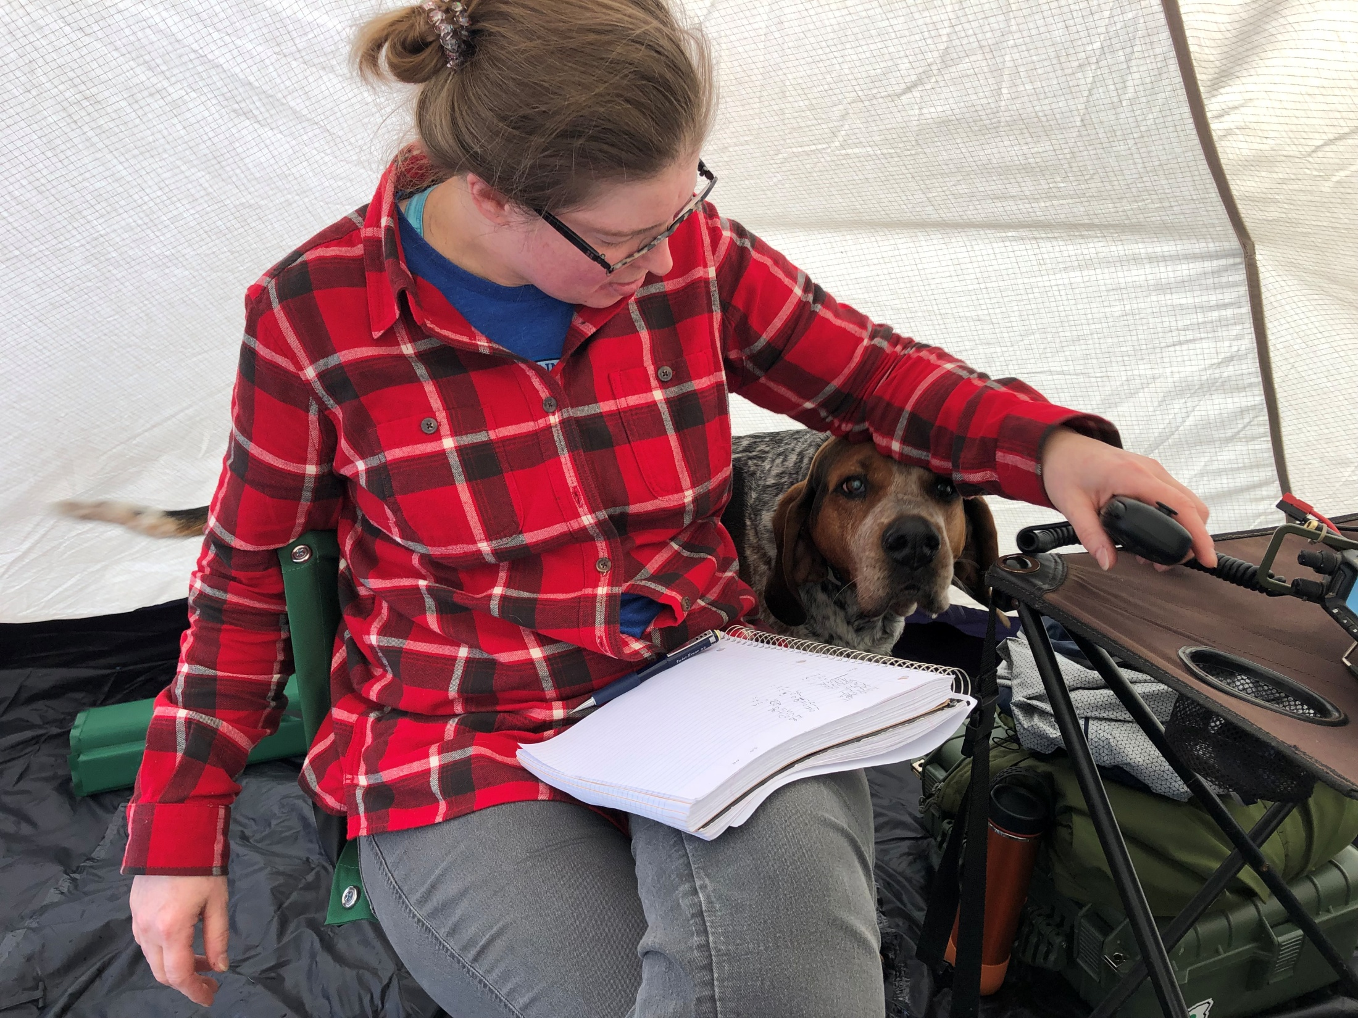

Slide 25
Field Deployment
Safety considerations – The general public doesn’t know what you’re doing and what to watch out for.
Flag or cone off wires, coax, etc. when appropriate.
Remember RF safety distances from the unaware park goers.
Park activation zone- “You and all your equipment must be within the boundaries of the park(s).”

Slide 26
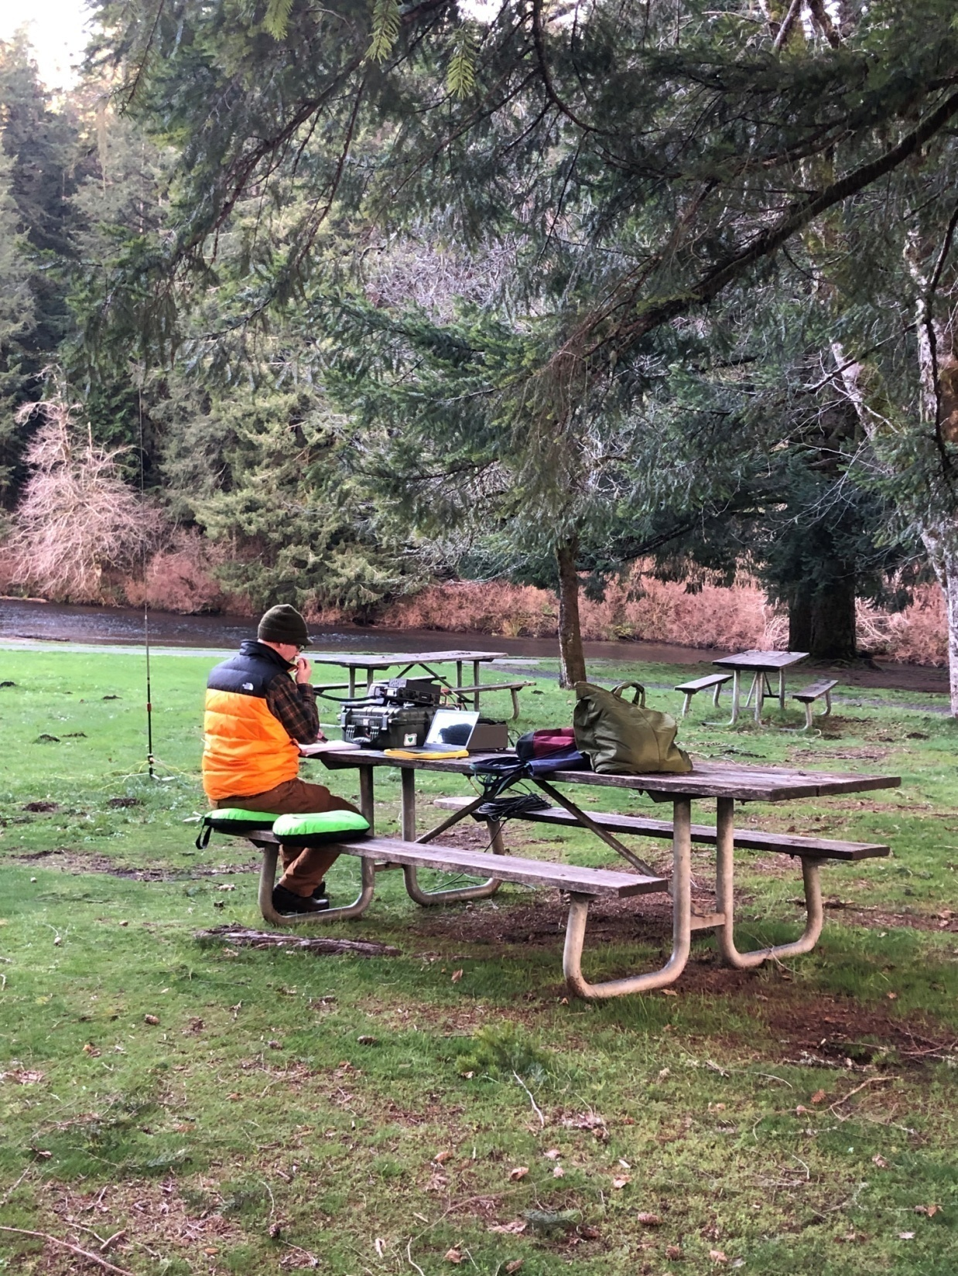

Slide 27
Equipment Considerations
Radio – Home rig, something small and portable, QRP?
Antenna – Simple wire dipoles, small telescoping verticals, ham sticks,etc.
Power source – Battery, generator, vehicle powered. If powered from you car, make sure you can still drive home. Remember proper wiring techniques. Fuses, wire gauge, Andersons are best.
Logging – Computer, paper, phone APPs. Paper doesn’t need batteries and always works.

Slide 28
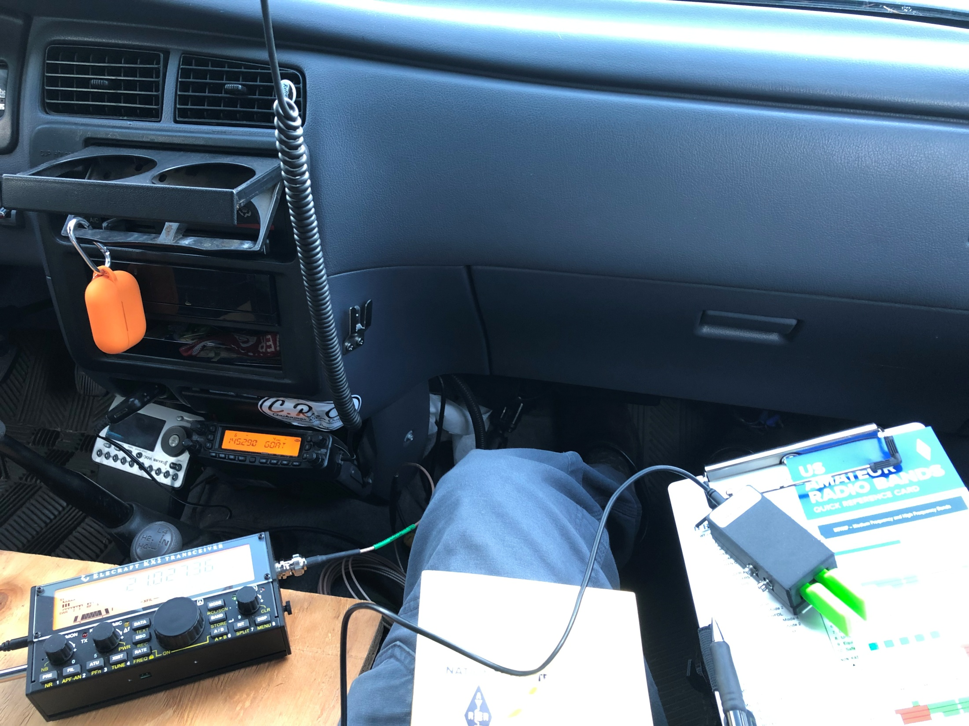

Slide 29
Creature Comforts
Table and chairs - The more comfortable you are, the longer you can stay in the park. Many locations will have picnic tables. But sometimes the best view requires your own furniture.
Sun shade or Tent – Limit your exposure to the elements. Don’t cause yourself an emergency situation.
Beverages – Stay hydrated.
Snacks – PCT, those folks will eat or drink anything.
Blankets or extra clothing.
Flash lights, USB adapters, phone chargers.
Extra writing utensils, paper.
Not all parks have bathroom facilities.

Slide 30
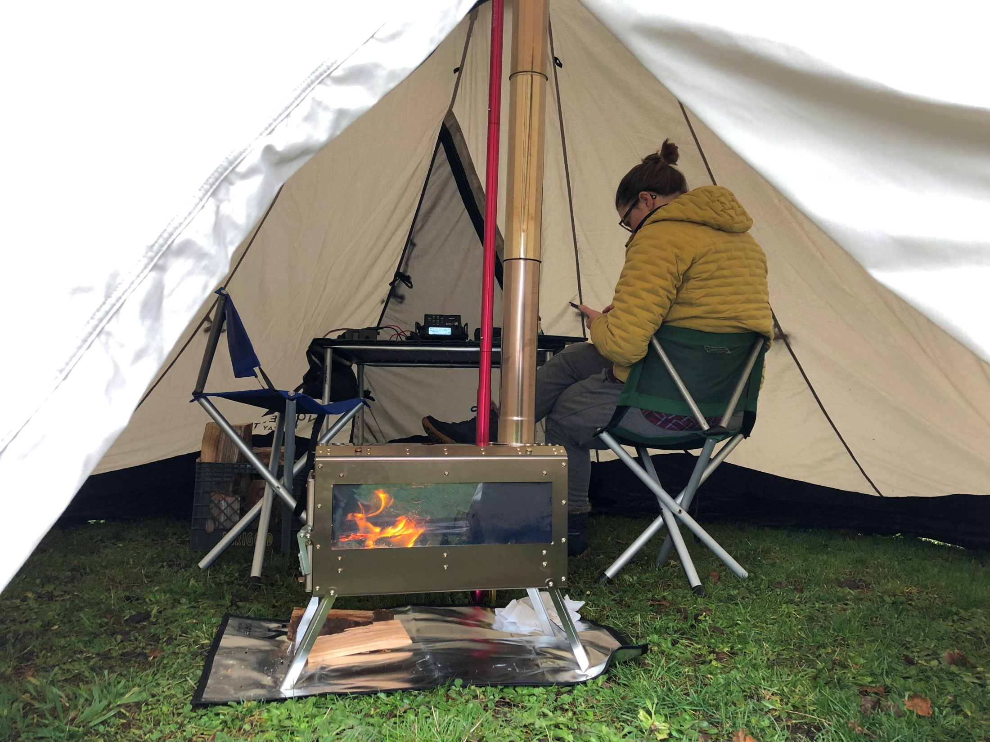

Slide 31
Spotting
POTA App self spot.
Spotting can be scheduled before you leave the house.
It’s generally easy to tell once you’ve been spotted.
Spotting others to help them out. Especially when they do not have internet/cell service.
Re spot – Be sure you spot the information accurately.
Reverse Beacon Network – RBN CW spotting.

Slide 32
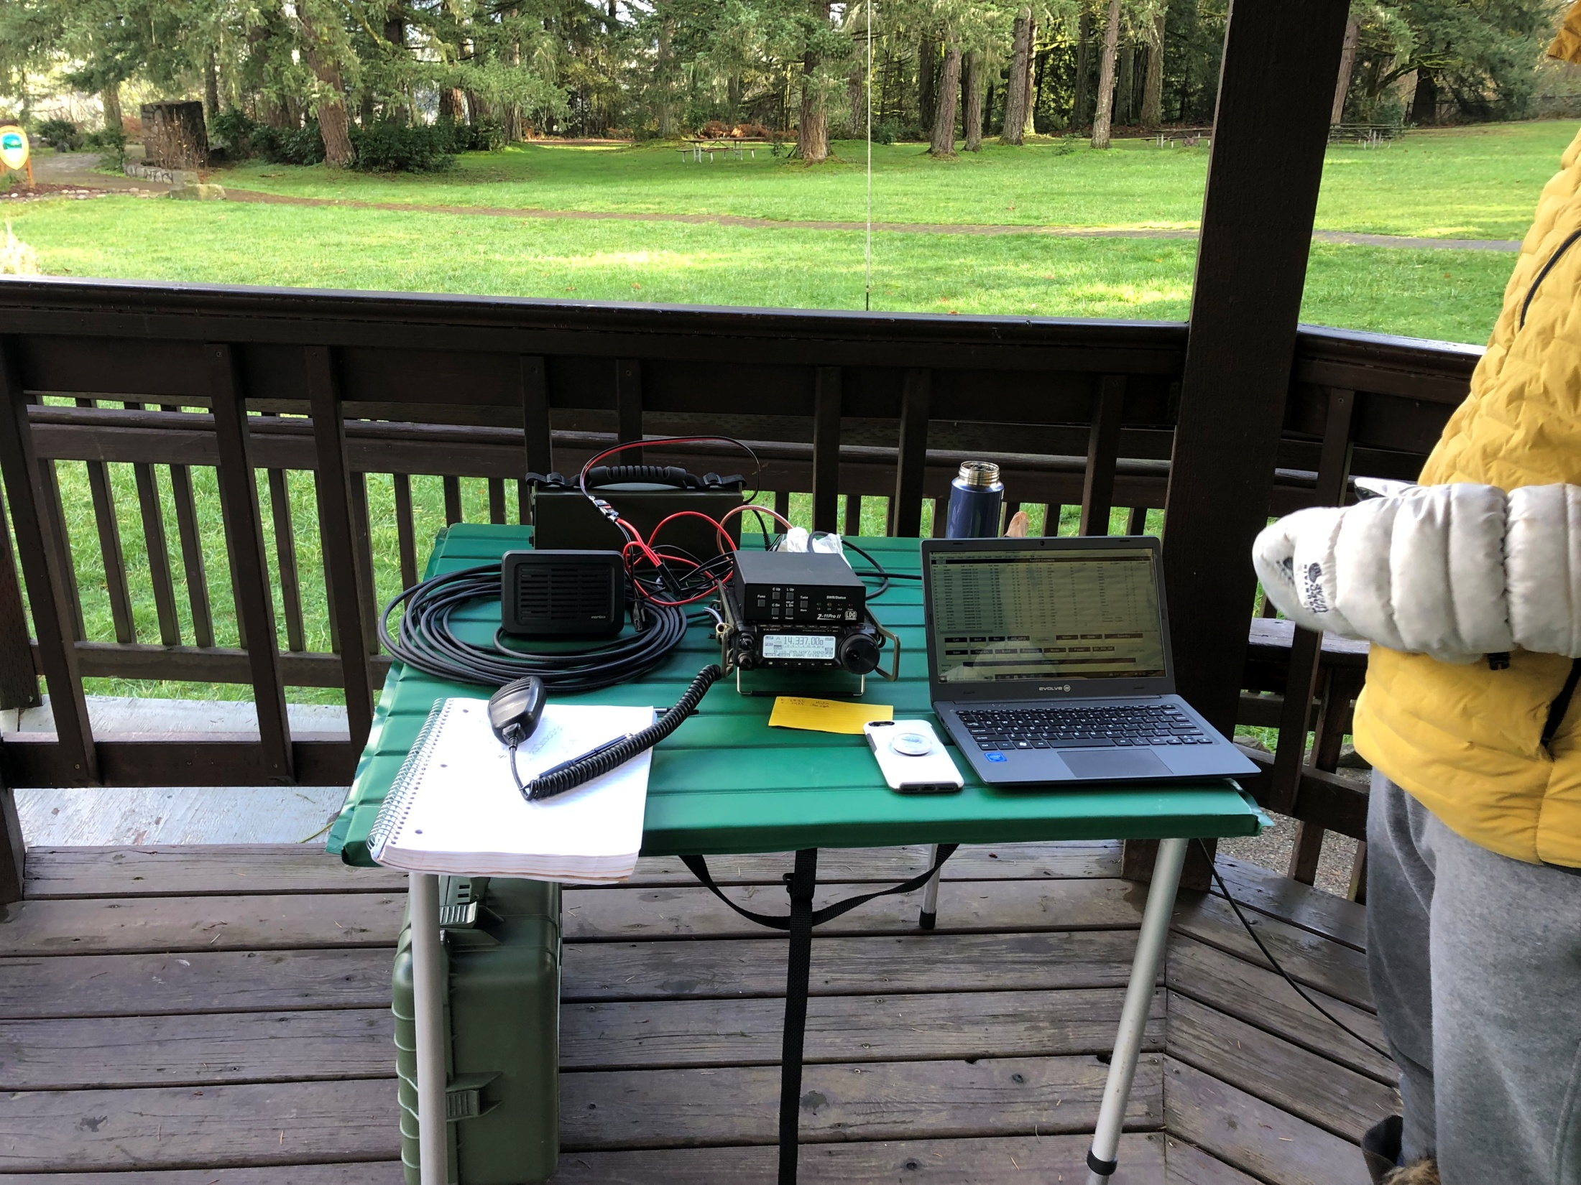

Slide 33
Logging Process
The exchange – Date, UTC time, callsign, band, mode. These are the only data points required for POTA logging.
Park to Park – Log Park#
Export ADIF file from your own logging software then upload to the POTA website, or manually enter contacts from the beta manual log entry.

Slide 34
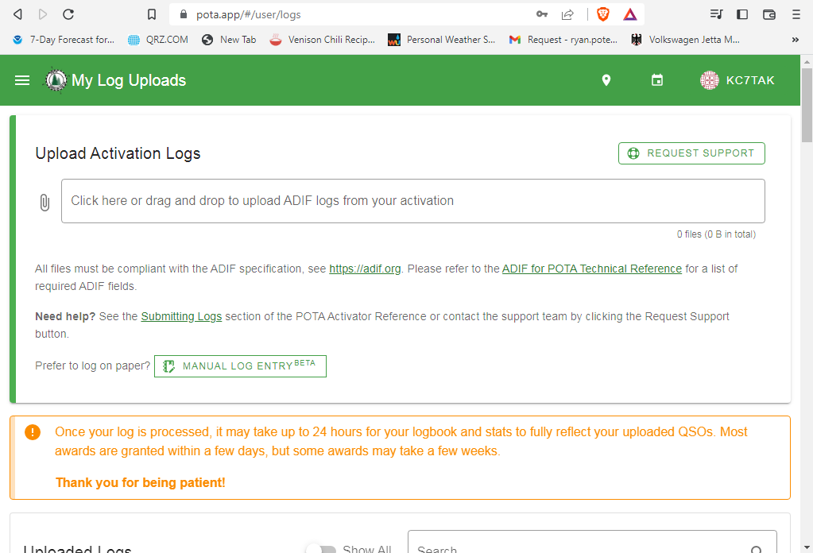

Slide 35
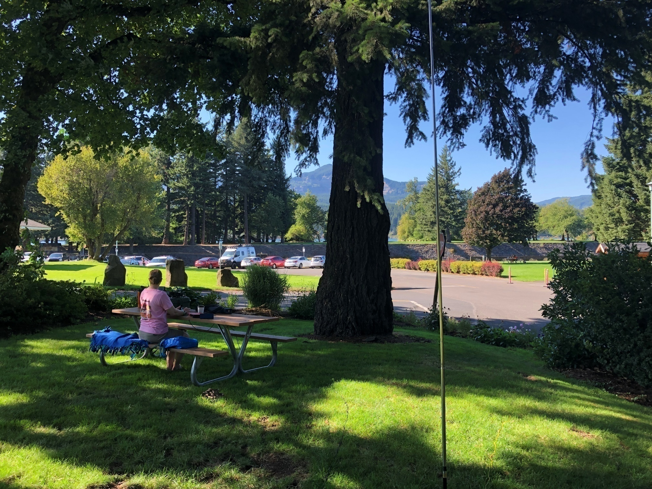

Slide 36
Public Relations
Remember to be an ambassador to our great hobby and community service.
Be approachable and show interest in telling others about the hobby and POTA.
Keep it simple and low tech. Avoid too much jargon if possible.

Slide 37
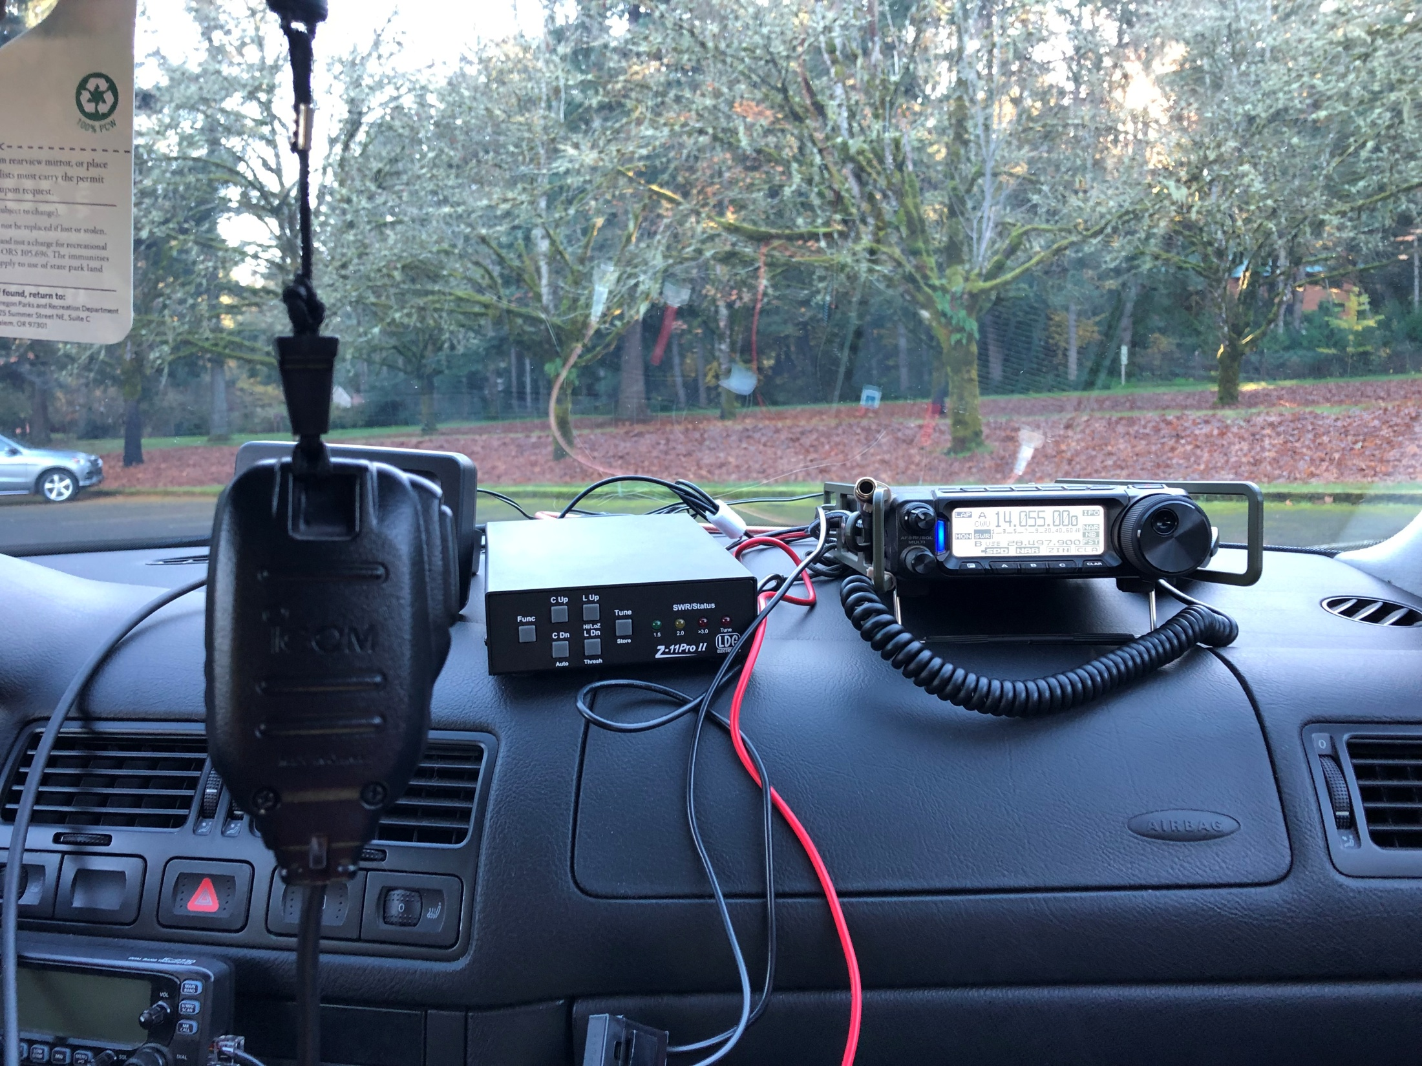

Slide 38
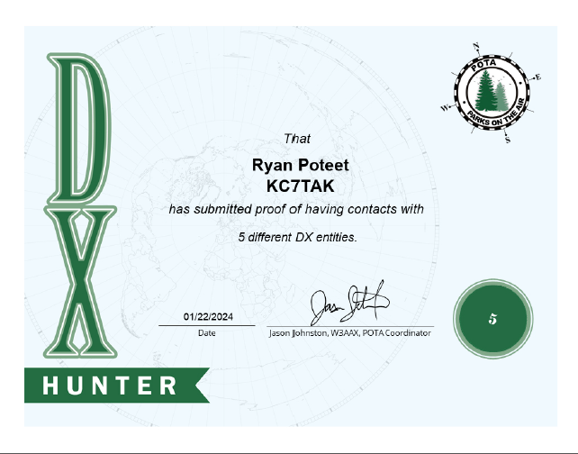
Awards
Wall paper opportunities.
Measure your progress.
You start to recognize stations just like when contesting or participating in nets.
The POTA site keeps track of all your awards and you can print from the site.

Slide 39
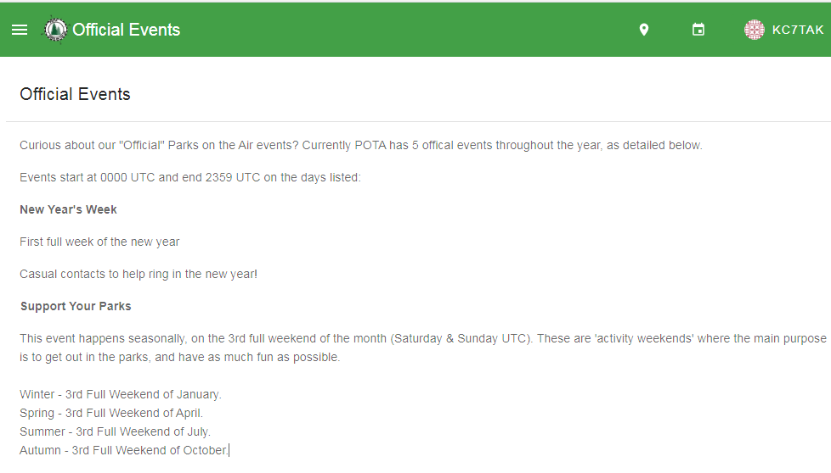
POTA Yearly Events

Slide 40
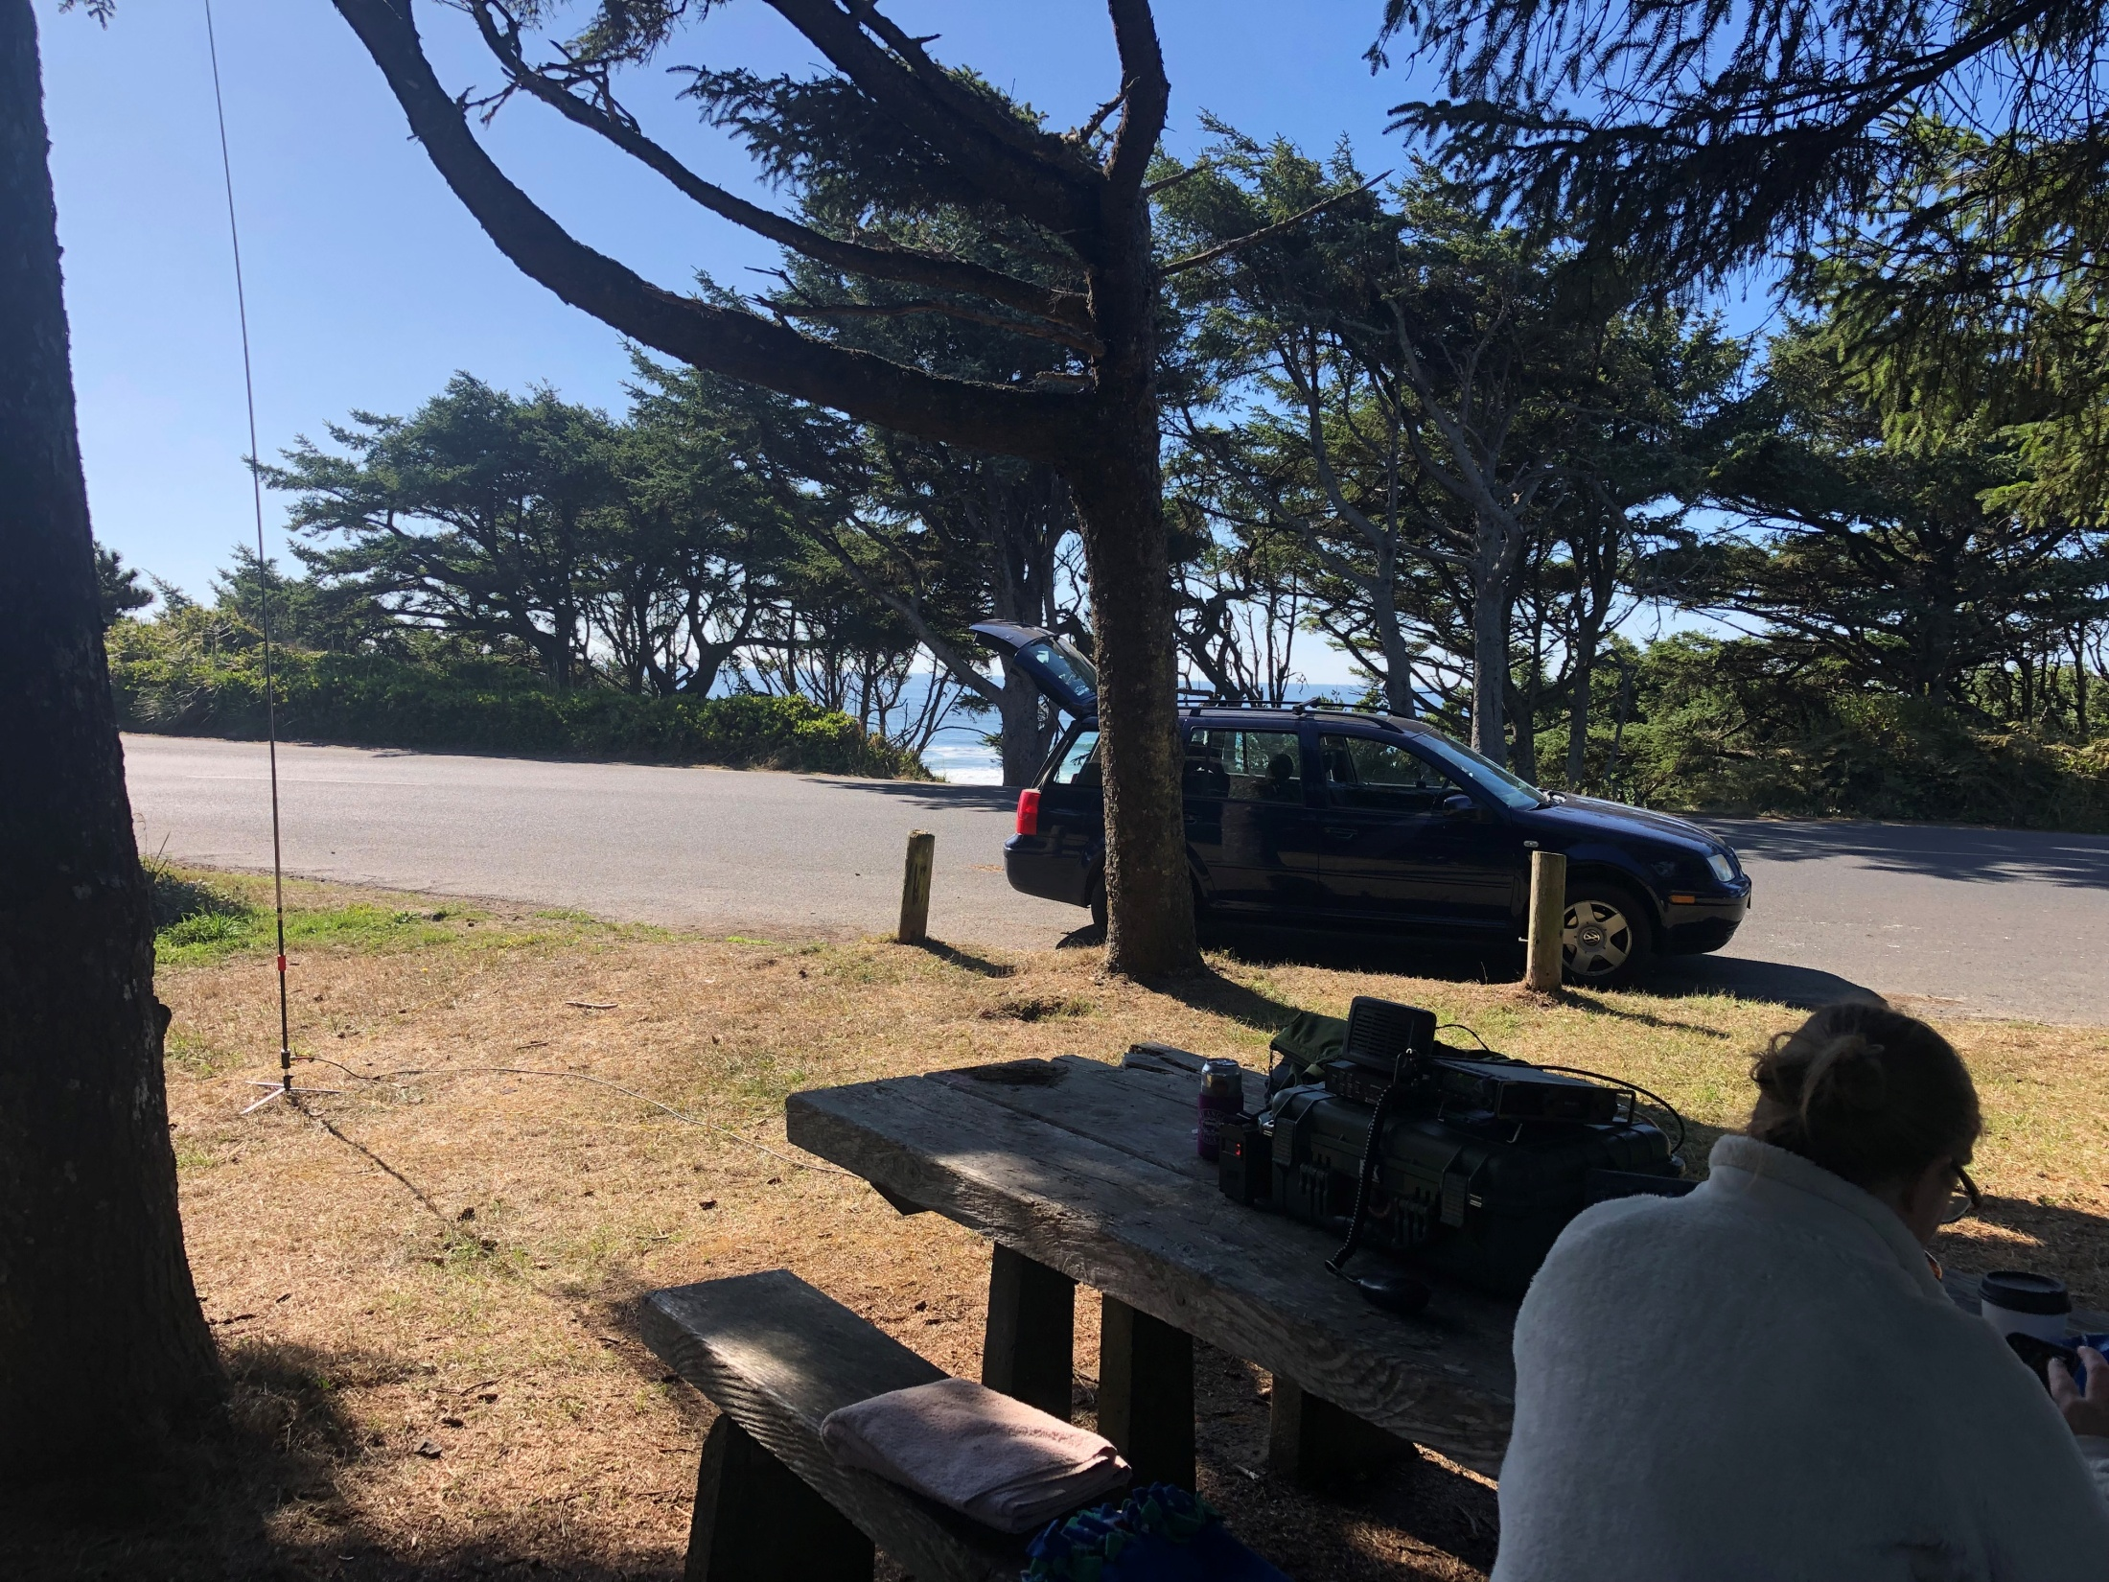

Slide 41
Advanced Topics
Multi Parks
Working P2P
Dual and triple ops.
Early shift
Late shift
Rover
Band propagation report
Frequencies to avoid – Maritime mobile 14.300 etc.
Working the locals
Kilo and challenging awards - N1CC 10 different bands from 10 different parks.
Parks on the Air ( POTA) Facebook group

Slide 42
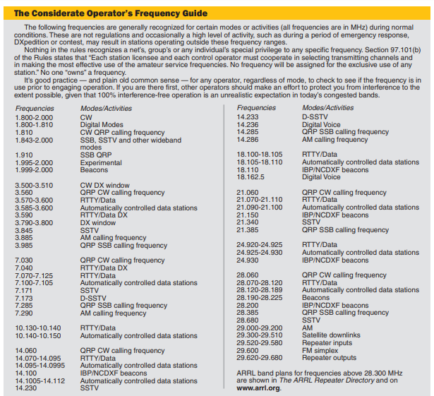

Slide 43
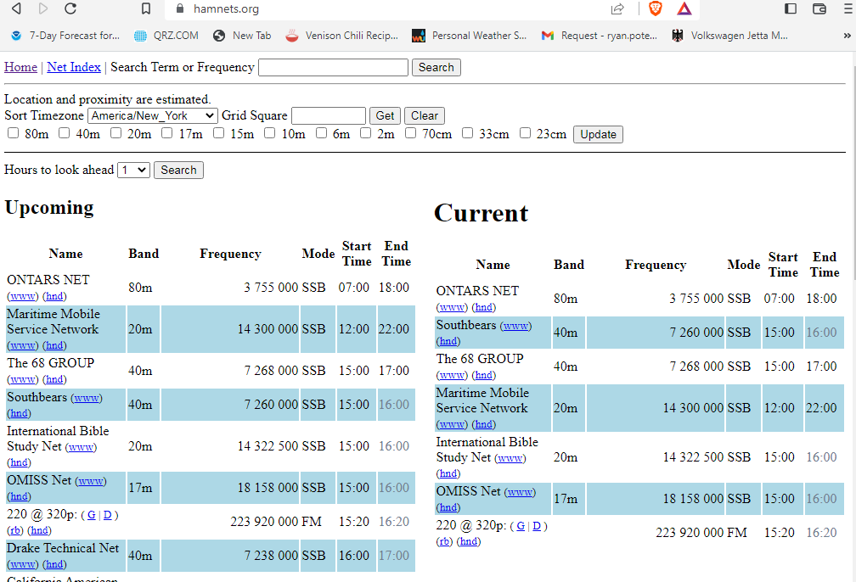

Slide 44
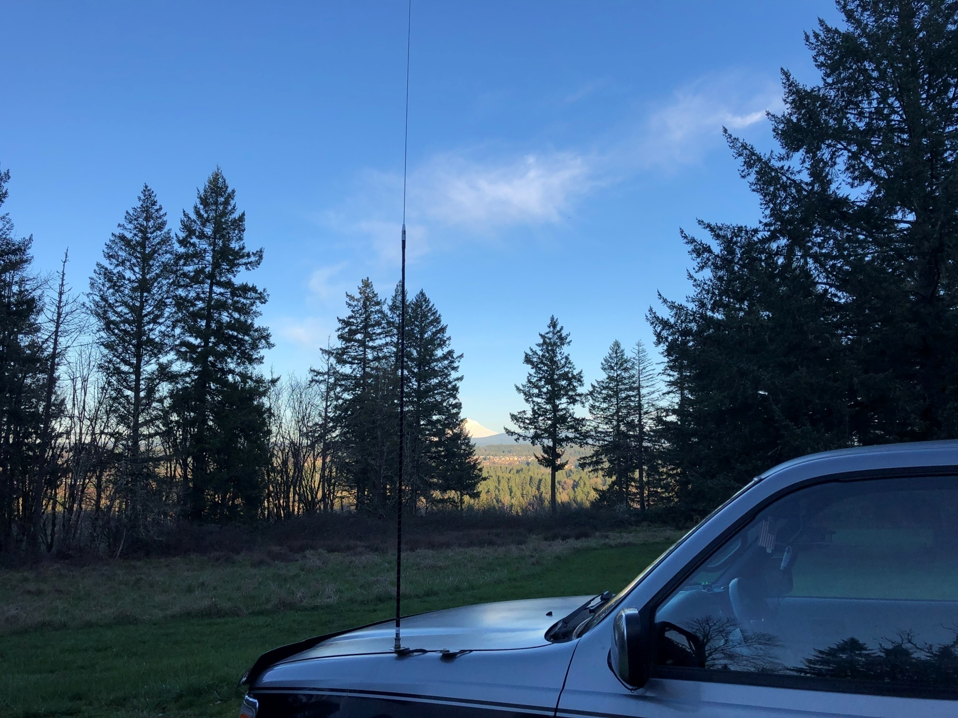

Slide 45
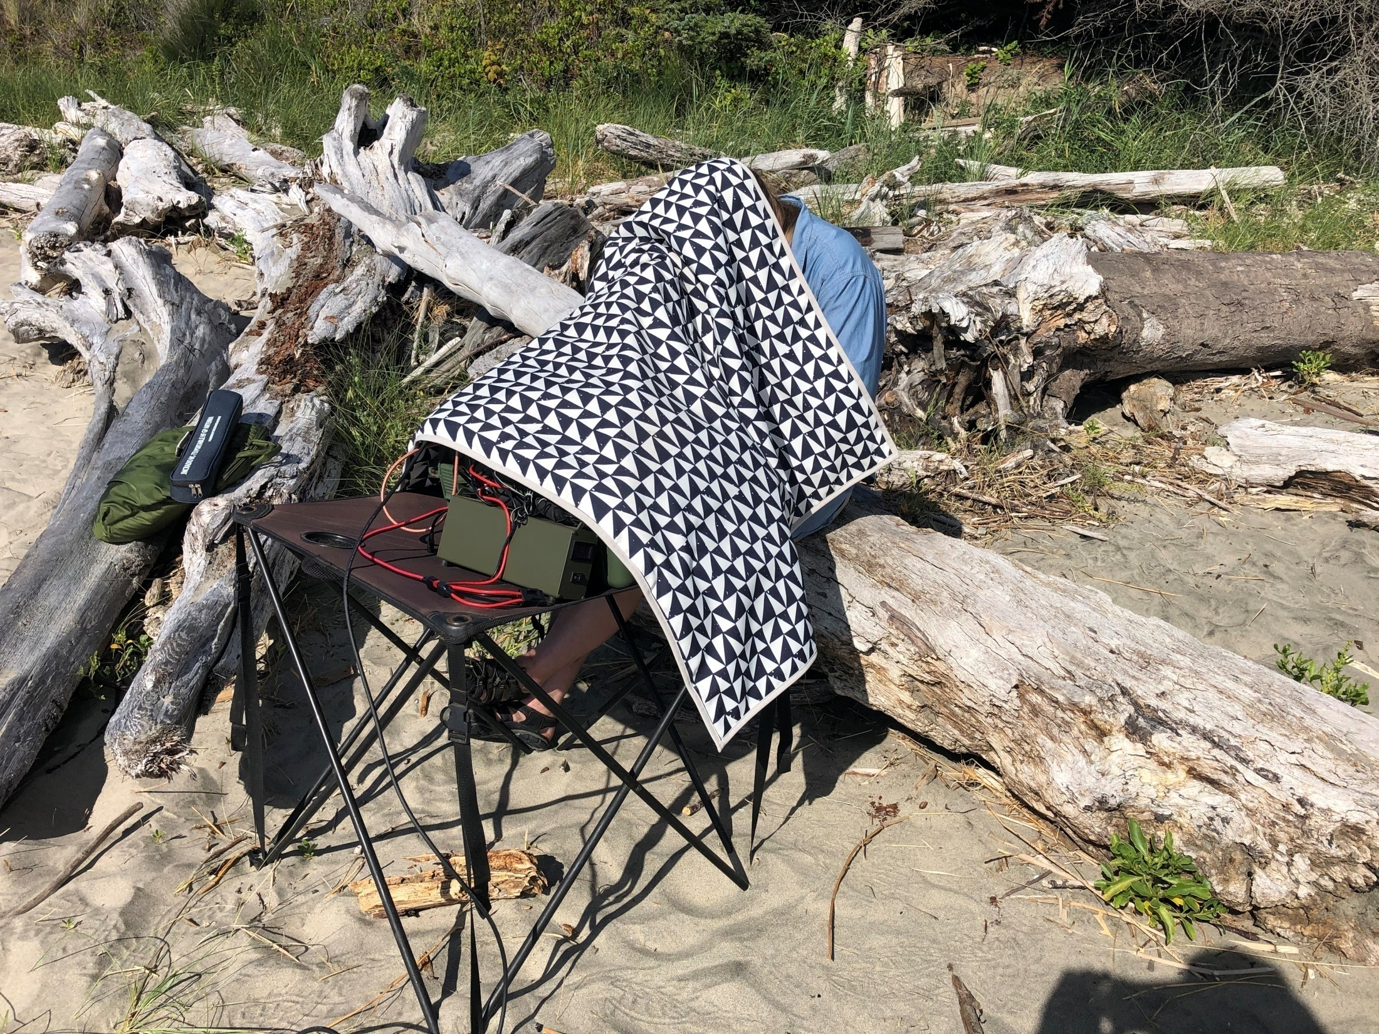

Slide 46
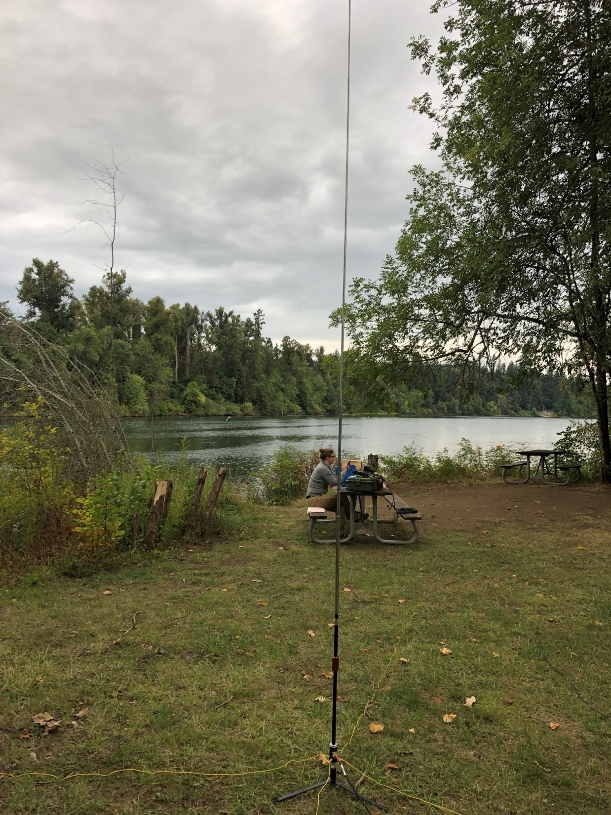

Slide 47
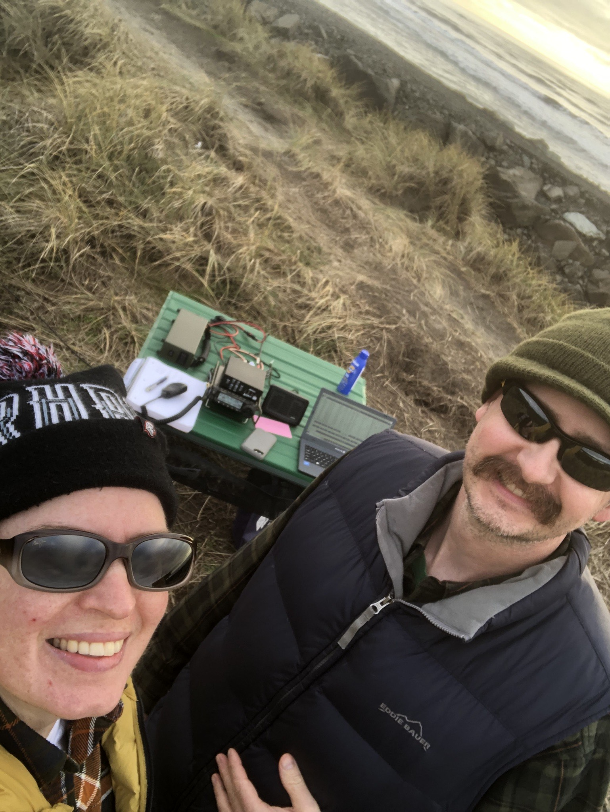

Slide 48
Remember to Have Fun!

