Slide 1
Crimping & Soldering
When to do which?
Clackamas ARES
Steve Jensen KE7GXC
KE7GXC@gmail.com
Rev. 14-May-2026
Notes:
Revision: 14-May-2026
Steve Jensen
Clackamas County ARES EC
KE7GXC@gmail.com

Slide 2
Objectives
Lets talk about
Crimping
Soldering
Protection – Strain Relief
When to use each --

Slide 3
Openers
What are the enemies of electrical connections?
  Corrosion
  Vibration
  Moisture
  Other stressors
Notes:
Atmospheric considerations
Water
Corrosive environments --

Slide 4
The situation - crimping
Crimping connector terminals is the best solution – technique used in aircraft, autos, elsewhere
Pros:
  Gas-tight connection of wire & terminal
  Better vibration resistance

Slide 5
The situation - crimping
Crimping connector terminals is the best solution – technique used in aircraft, autos, etc.
Cons
  Connection failure when incorrect matching of components
  Connection failure when out of specification components
  Must have the correct parts
  Must have correct crimp tool

Slide 6
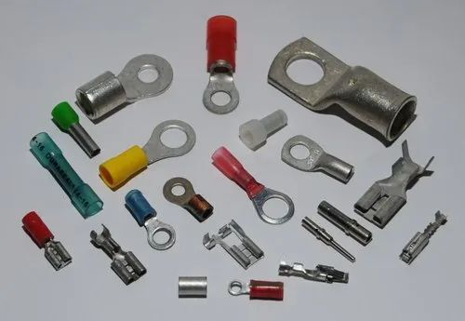
The situation - crimping
Notes:
Connector terminals come in a wide variety of shapes, sizes and applications ---

Slide 7
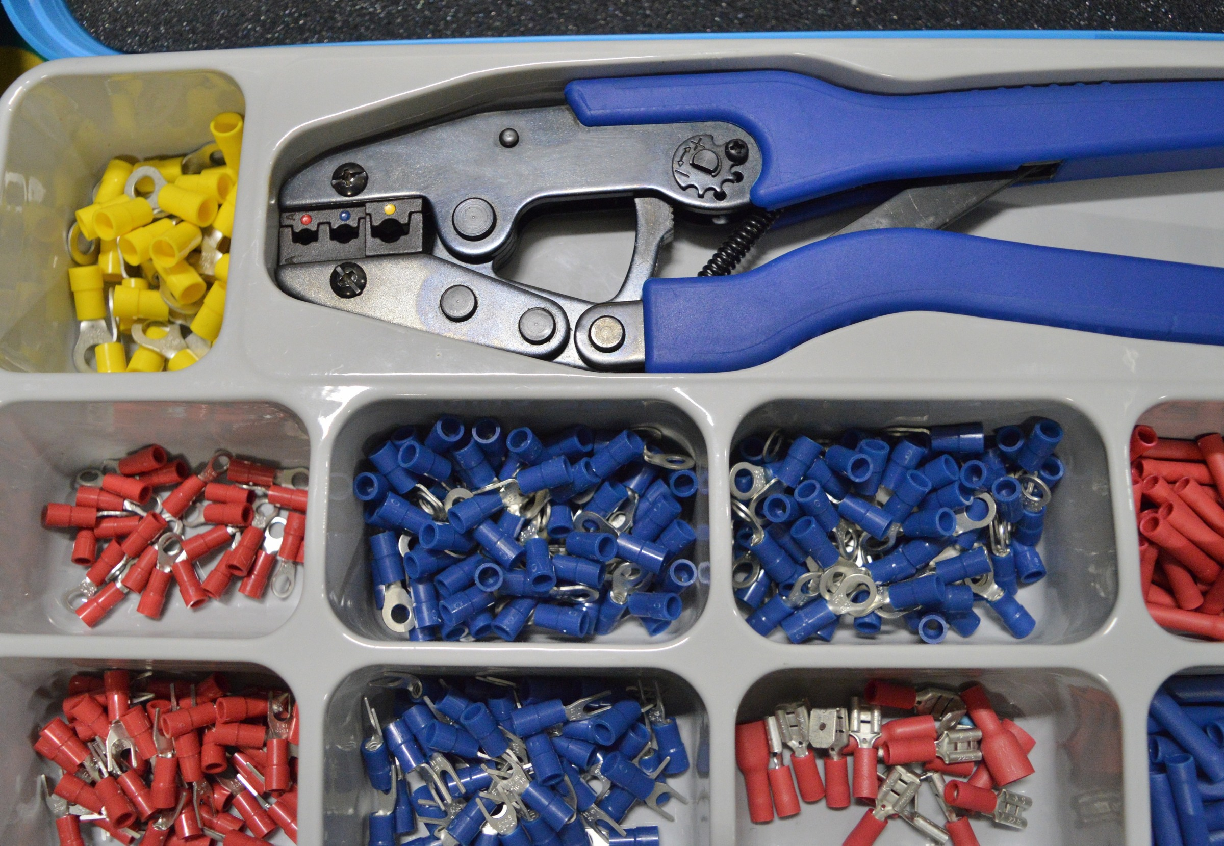
The situation – crimping - automotive
Notes:
Use the correct crimping tool for the connector or terminal

Slide 8
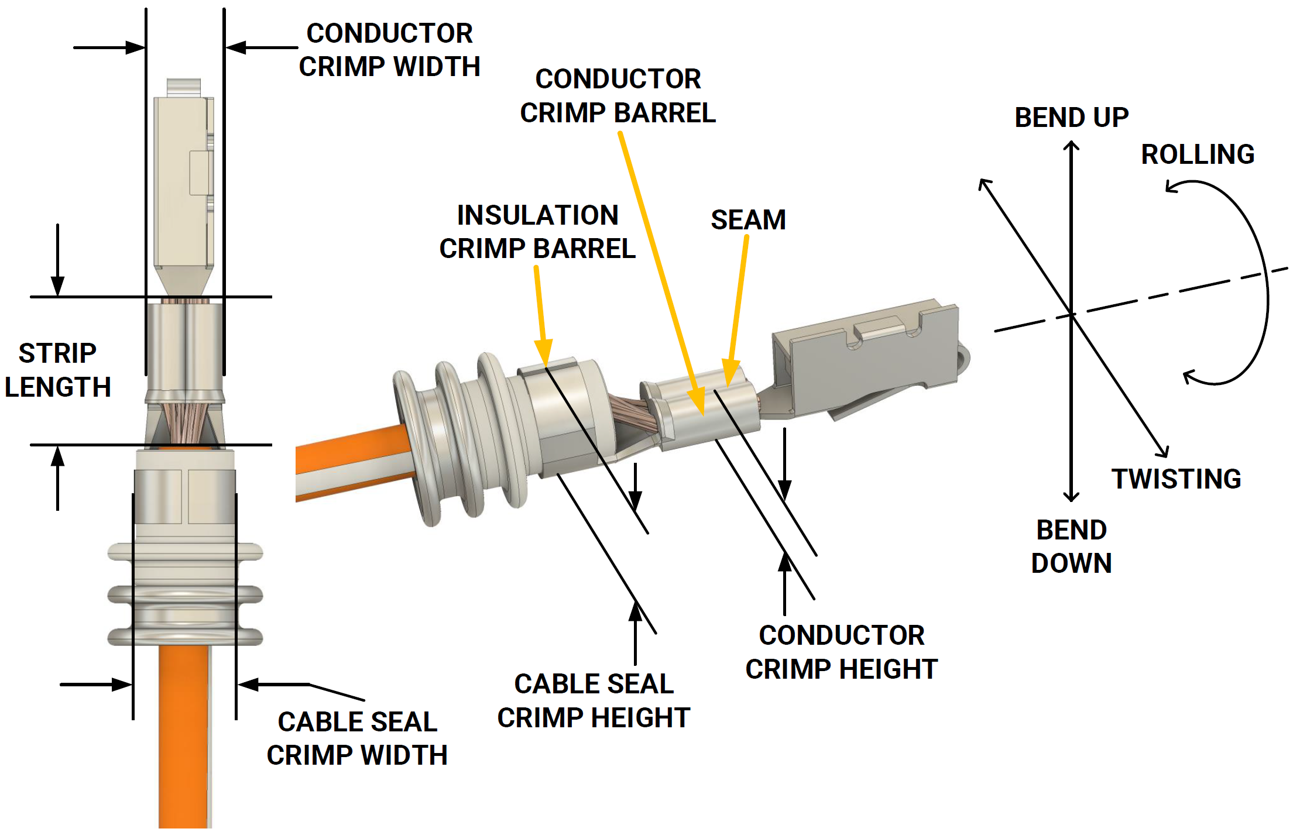
The situation - crimping
Notes:
What’s important in crimped terminals?????

Slide 9
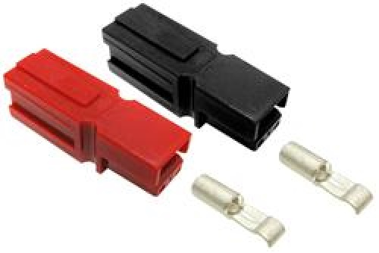

The situation – crimping PP-30’s
PP-30 connector
Crimp area
Notes:
Properly crimped, using correct tools, to specification and using components of correct size, connector terminals and wire size are gas tight and resist corrosion.

Slide 10
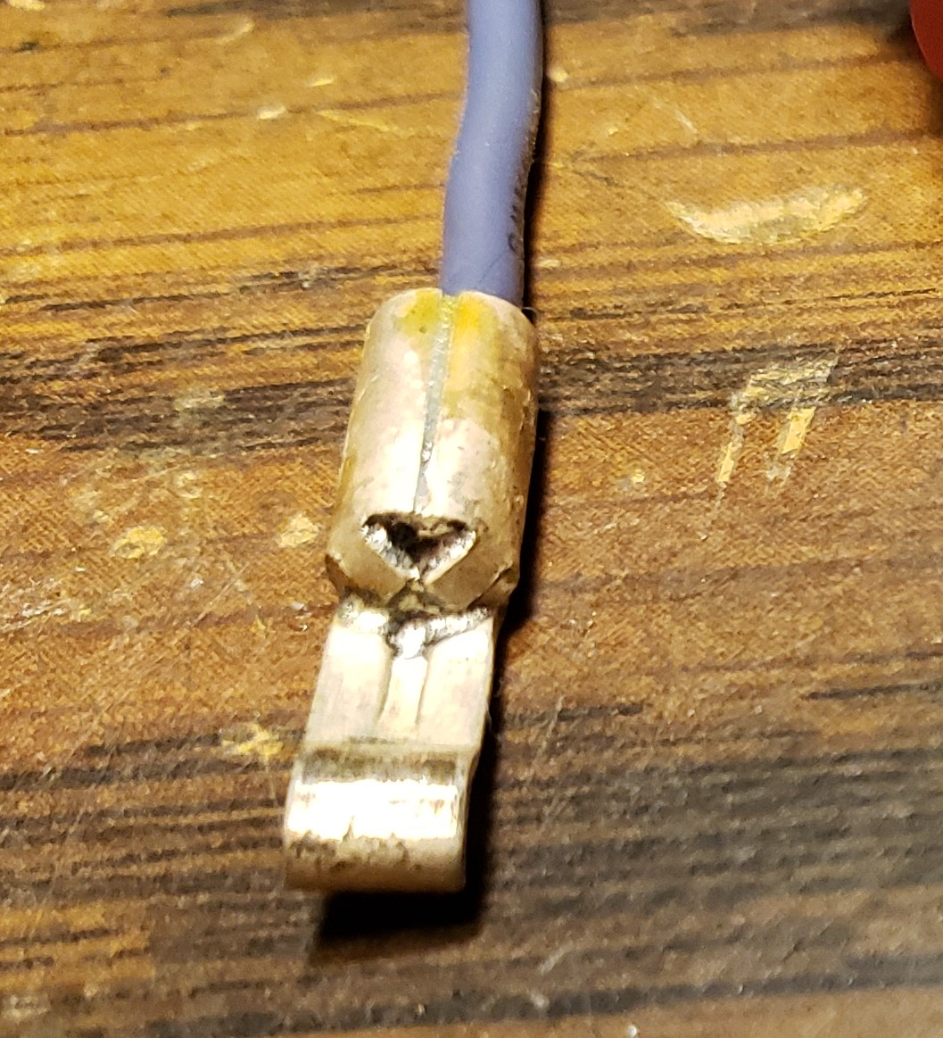
The situation – crimping PP-30’s
PP-30 connector
Crimp imperfect, solder it
Notes:
Properly crimped, using correct tools, to specification and using components of correct size, connector terminals and wire size are gas tight and resist corrosion.
Wrong size terminal.
Wrong spec wire.

Slide 11
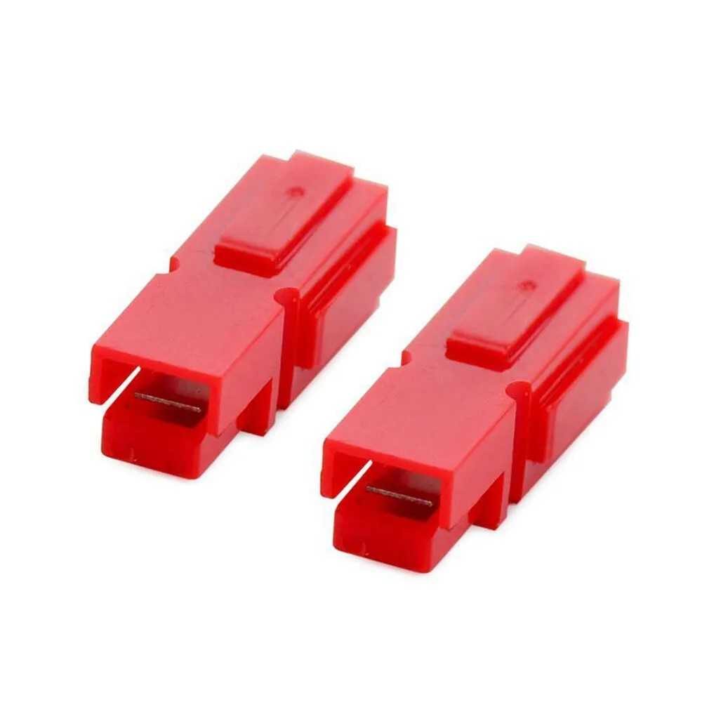
The situation – crimping PP-30’s
PP-30 connector
housing “compatible” but … not …
Notes:
Properly crimped, using correct tools, to specification and using components of correct size, connector terminals and wire size are gas tight and resist corrosion.
Wrong size terminal.
Wrong spec wire.

Slide 12
The situation – crimping PP-30’s
PP-30 connector housing “compatible” but suspect
No trade mark on parts
Mechanical fit
Failure due to heating effects – deformation, melting of the connector housing ---
Notes:
Properly crimped, using correct tools, to specification and using components of correct size, connector terminals and wire size are gas tight and resist corrosion.
Wrong size terminal.
Wrong spec wire.

Slide 13
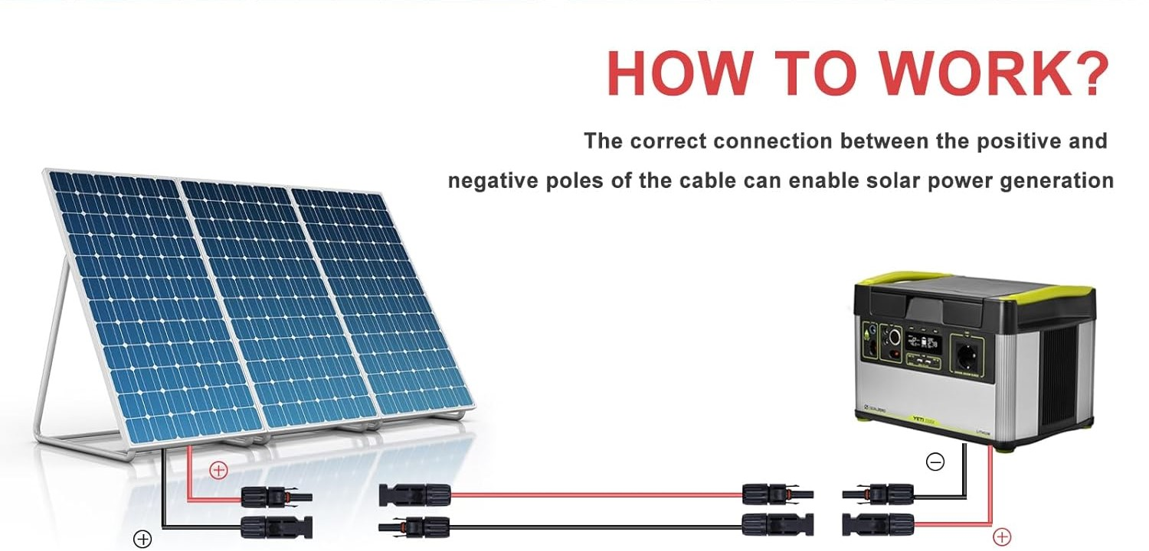
The situation – crimping for Solar
Solar in ham radio
Notes:
Solar “MC 4” connectors are the in terms of certain parameters, but some differences
MARBERO 200W Portable Solar Panel for Power Station IP68 Waterproof 200 Watt Foldable Solar Charger >23% High Efficiency Compatible with Solar Generator for Camping RV Outdoor Cloudy
https://www.amazon.com/dp/B0DNT2Q87P?tag=axetocarfi-20&th=1

Slide 14
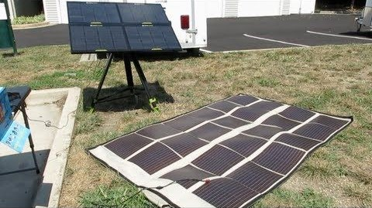
The situation – crimping for Solar
Solar in ham radio
Notes:
Solar “MC 4” connectors are the in terms of certain parameters, but some differences
MARBERO 200W Portable Solar Panel for Power Station IP68 Waterproof 200 Watt Foldable Solar Charger >23% High Efficiency Compatible with Solar Generator for Camping RV Outdoor Cloudy
https://www.amazon.com/dp/B0DNT2Q87P?tag=axetocarfi-20&th=1

Slide 15
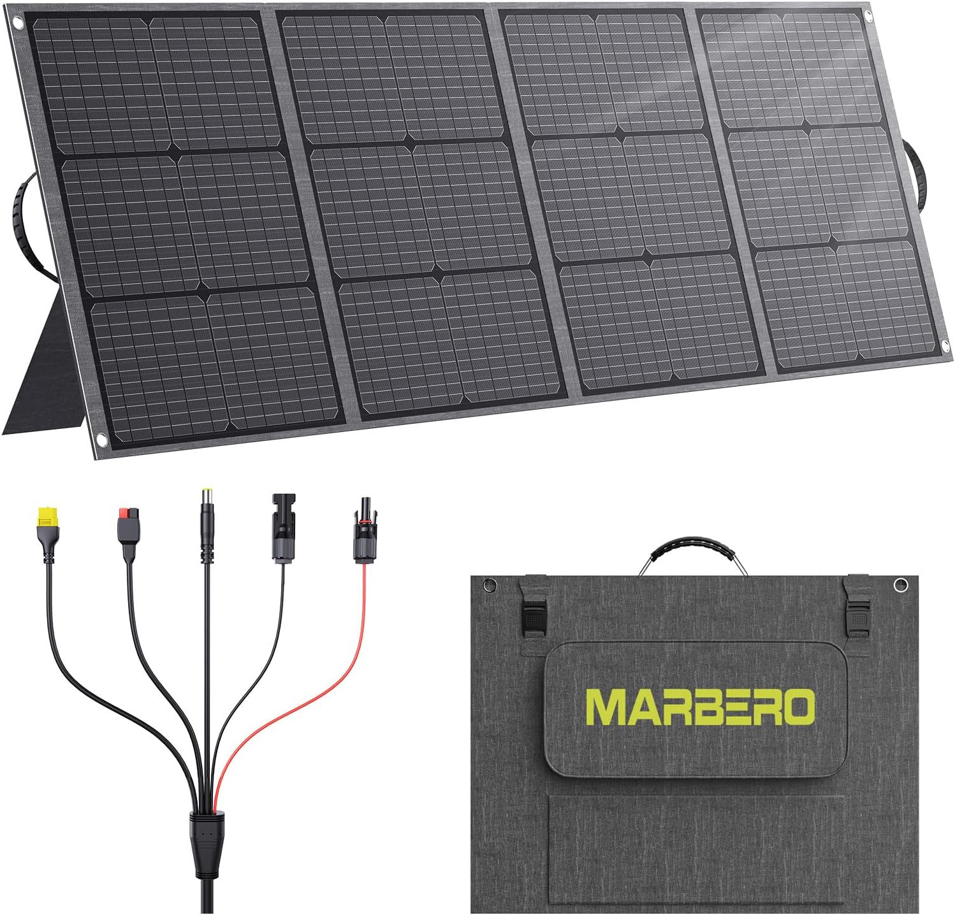
The situation – crimping for Solar
Solar in ham radio
Notes:
Solar “MC 4” connectors are the in terms of certain parameters, but some differences
MARBERO 200W Portable Solar Panel for Power Station IP68 Waterproof 200 Watt Foldable Solar Charger >23% High Efficiency Compatible with Solar Generator for Camping RV Outdoor Cloudy
https://www.amazon.com/dp/B0DNT2Q87P?tag=axetocarfi-20&th=1

Slide 16
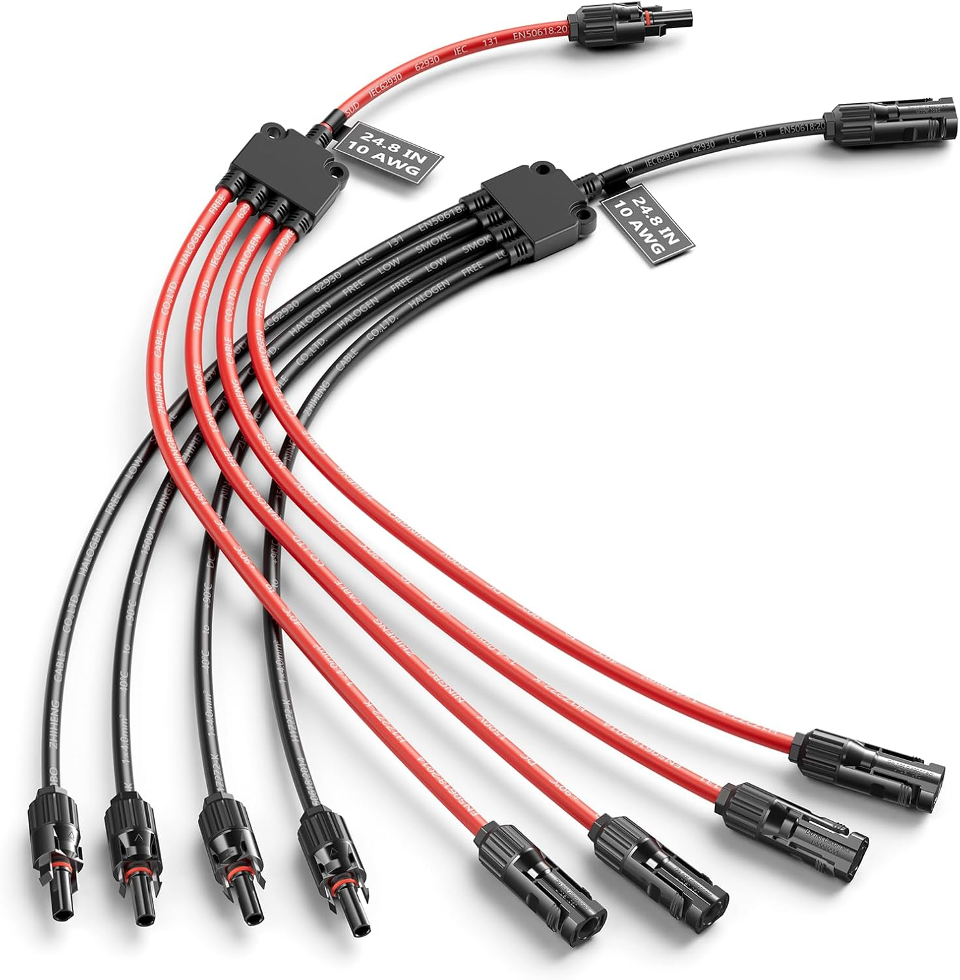
The situation – crimping for Solar
Notes:
Solar “MC 4” connectors are the in terms of certain parameters, but some differences

Slide 17
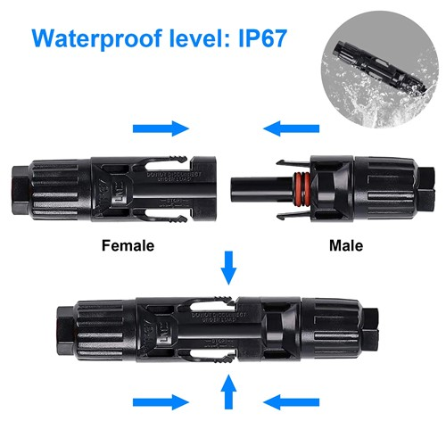
The situation – crimping for Solar
MC 4 connector
4 mm spec
Notes:
Solar “MC 4” connectors are the in terms of certain parameters, but some differences

Slide 18
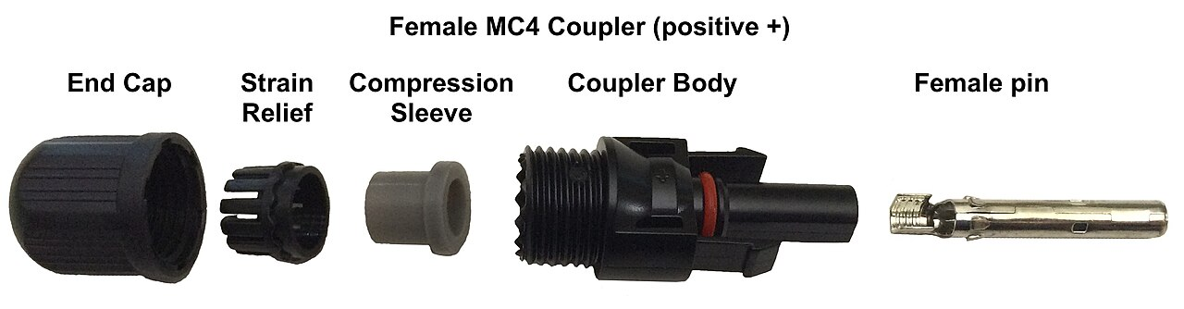
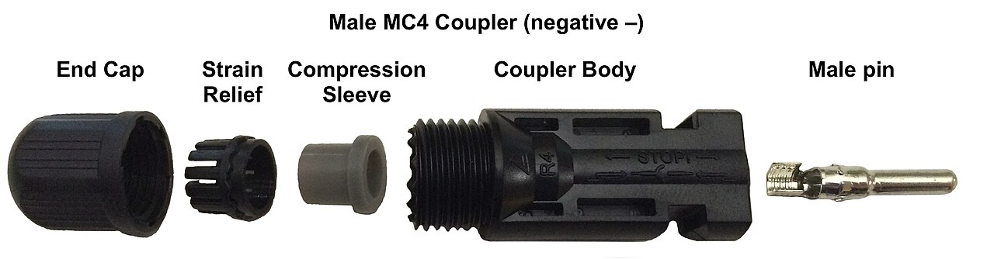
The situation – crimping for Solar
Notes:
Properly crimped, using correct tools, to specification and using components of correct size, connector terminals and wire size are gas tight and resist corrosion.
Wrong size terminal.
Wrong spec wire.

Slide 19
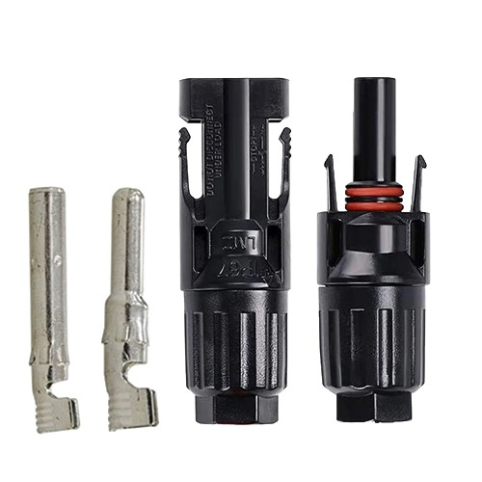
The situation – crimping for Solar
MC 4 connector
Variations in housings
Notes:
Properly crimped, using correct tools, to specification and using components of correct size, connector terminals and wire size are gas tight and resist corrosion.
Wrong size terminal.
Wrong spec wire.

Slide 20
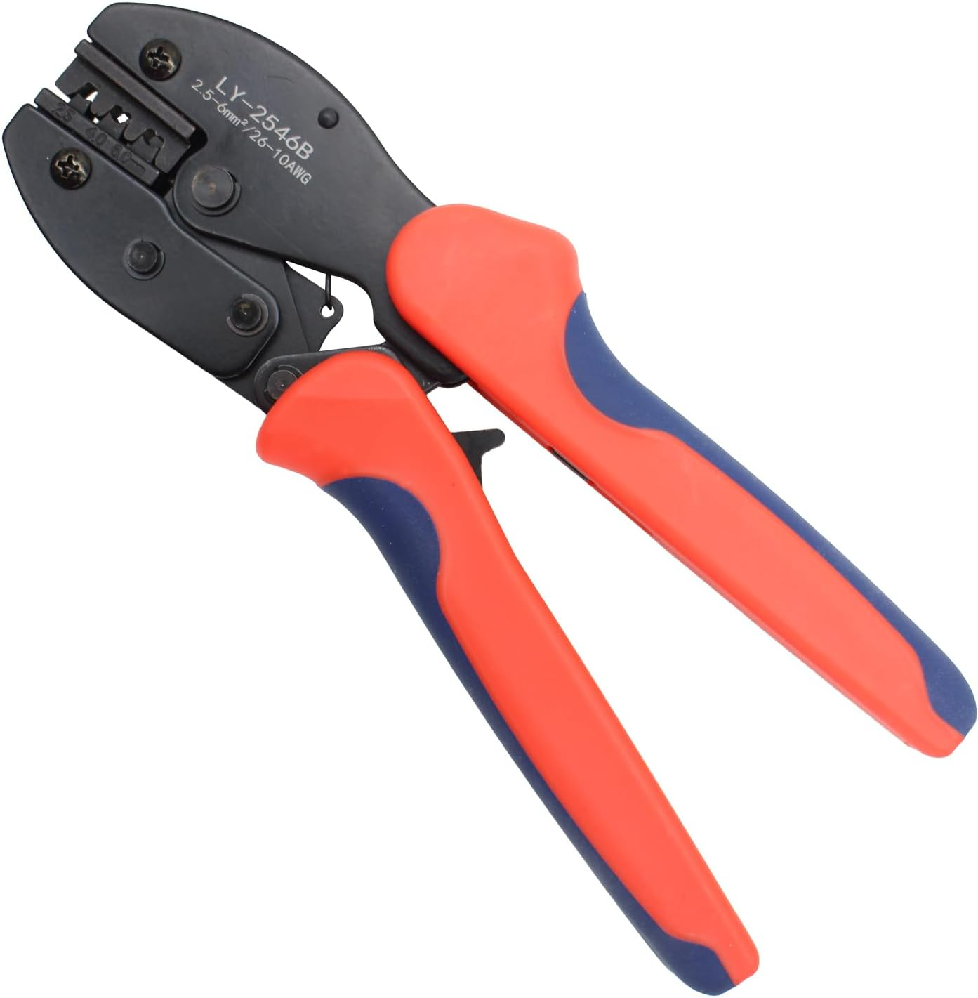
The situation – crimping for Solar
Target: 2.5 mm crimp
MC 4 connector
Proper crimping tool: 6mm for 10 AWG
Target: 6 mm crimp
Target: 4 mm crimp
Notes:
Properly crimped, using correct tools, to specification and using components of correct size, connector terminals and wire size are gas tight and resist corrosion.
Wrong size terminal.
Wrong spec wire.

Slide 21
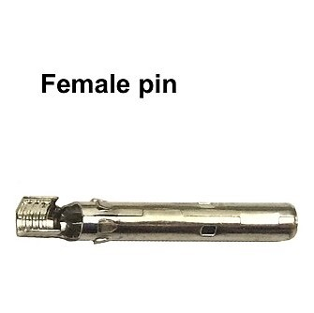
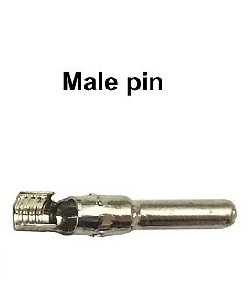
The situation – crimping for Solar
MC 4 problem: “loose” fit
Diameter target 4 mm and pin retention “interference” grip fit
Diameter target 4 mm
Notes:
Properly crimped, using correct tools, to specification and using components of correct size, connector terminals and wire size are gas tight and resist corrosion.
Wrong size terminal.
Wrong spec wire.

Slide 22
The situation – crimping for Solar
Summary:
For any connector use the proper crimping tool for the connector terminal and wire size and environment
Notes:
Properly crimped, using correct tools, to specification and using components of correct size, connector terminals and wire size are gas tight and resist corrosion.
Wrong size terminal.
Wrong spec wire.

Slide 23
The situation - soldering
Soldering connector terminals is often a needed solution – why use it?
Pros:
  Gas-tight connecting of wire & terminal when crimping is incomplete or incorrect
Cons
  Not as vibration resistant
  Under high-current stress the solder can become molten and exit the joint ---

Slide 24
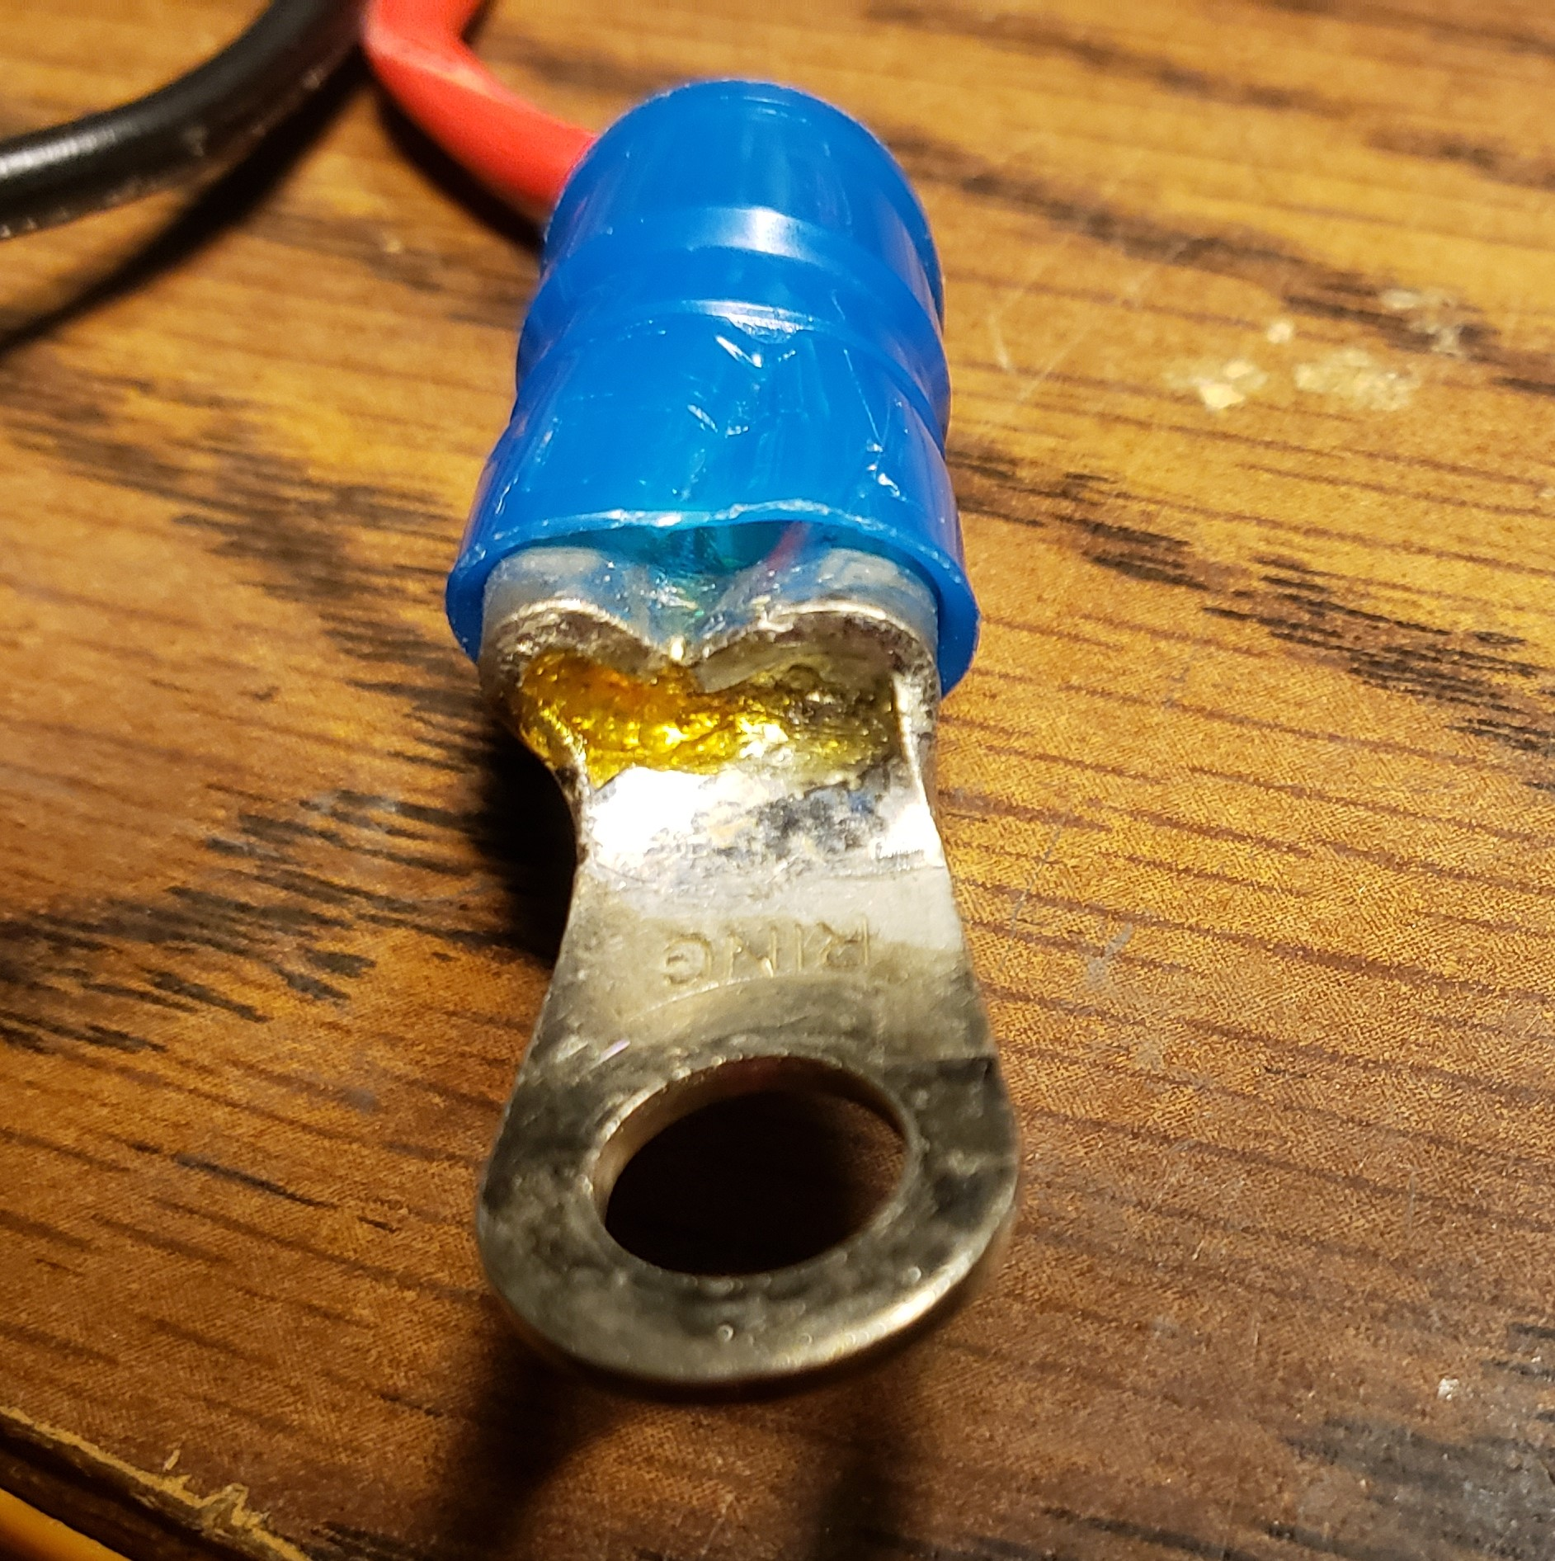
The situation - soldering

Slide 25
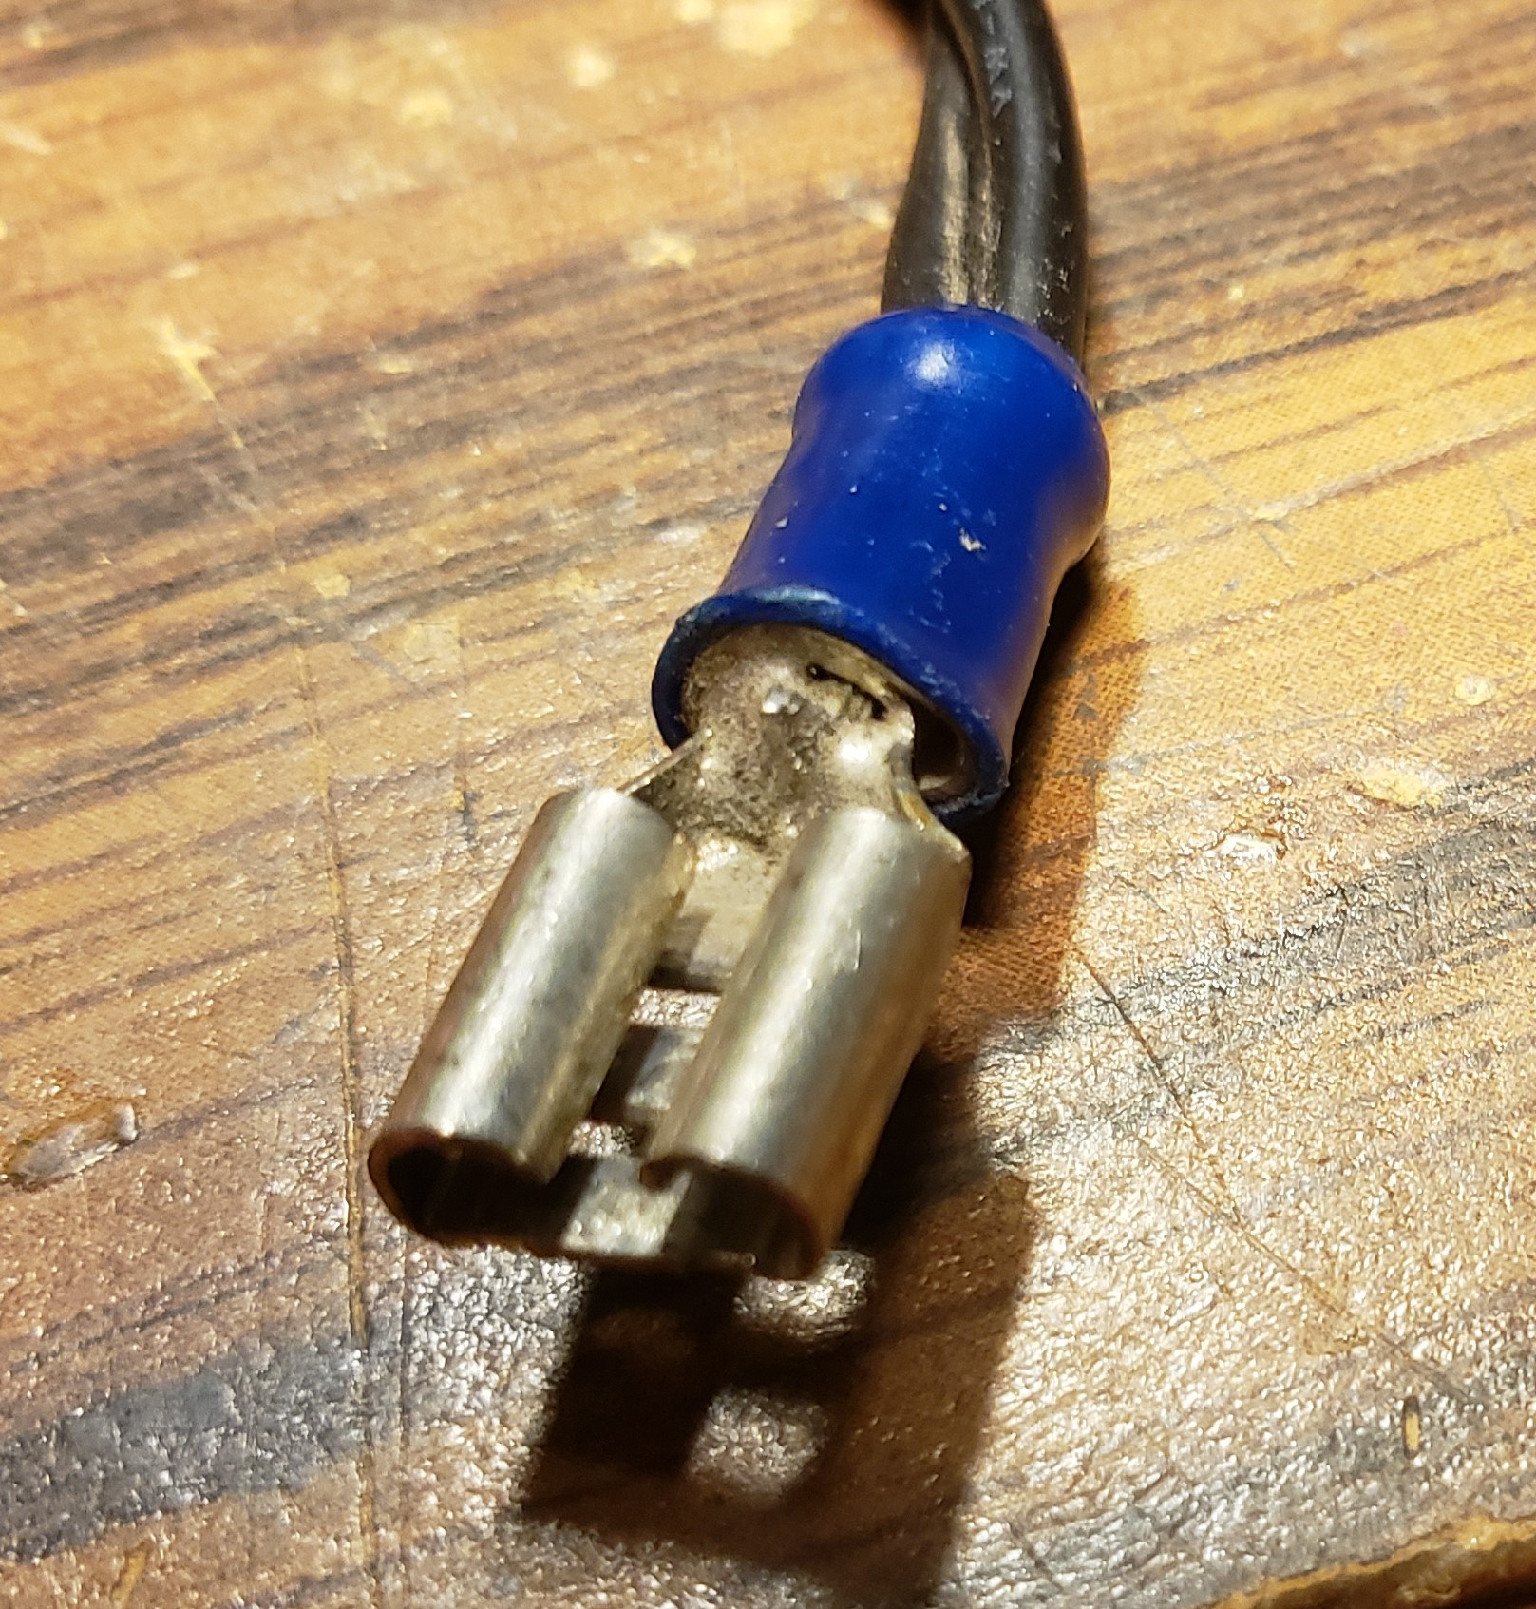
The situation - soldering

Slide 26
The situation - soldering

Slide 27
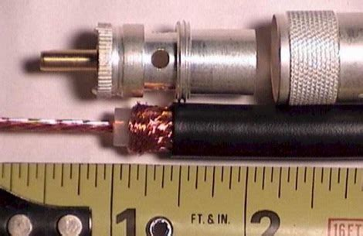
The situation – PL-259’s

Slide 28
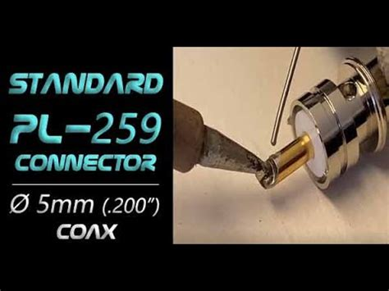
The situation – PL-259’s

Slide 29
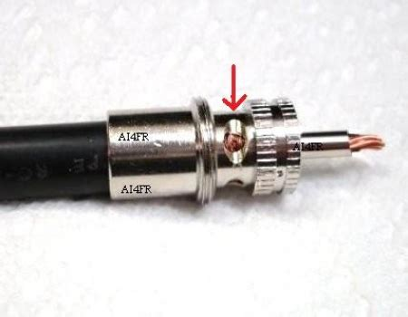
The situation – PL-259’s
Solder PL-259

Slide 30
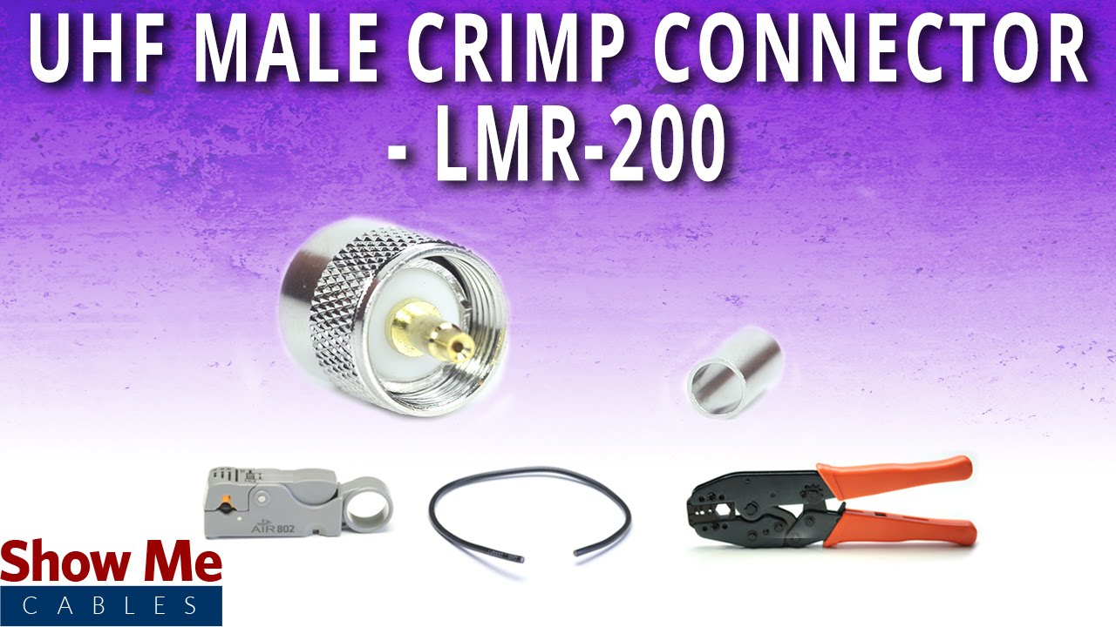
The situation - crimping
Notes:
Properly crimped, using correct tools, to specification and using components of correct size, connector terminals and wire size are gas tight and resist corrosion.
Wrong size terminal.
Wrong spec wire.

Slide 31
Strain Relief
Strain relief
  Use zip ties, electrical tape, tubing to protect wiring

Slide 32
Strain Relief
Vehicles
Protection
Restraint
Abrasion resistant

Slide 33
Strain Relief

Slide 34
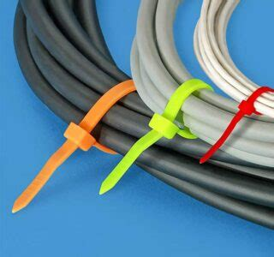
Strain Relief

Slide 35
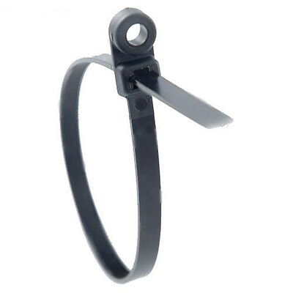
Strain Relief

Slide 36
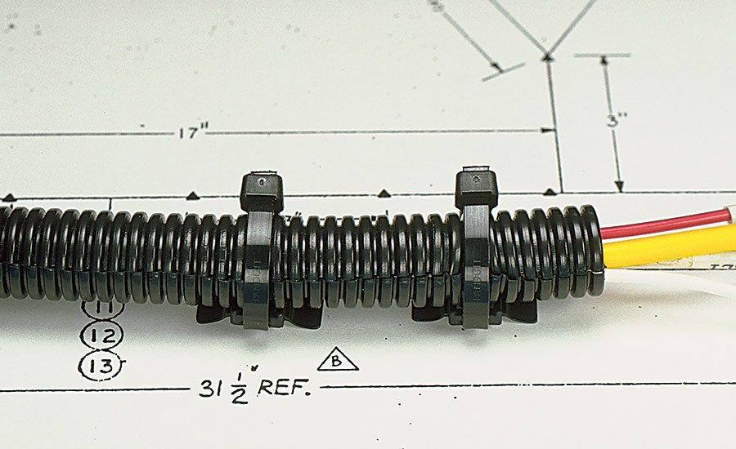
Strain Relief

Slide 37
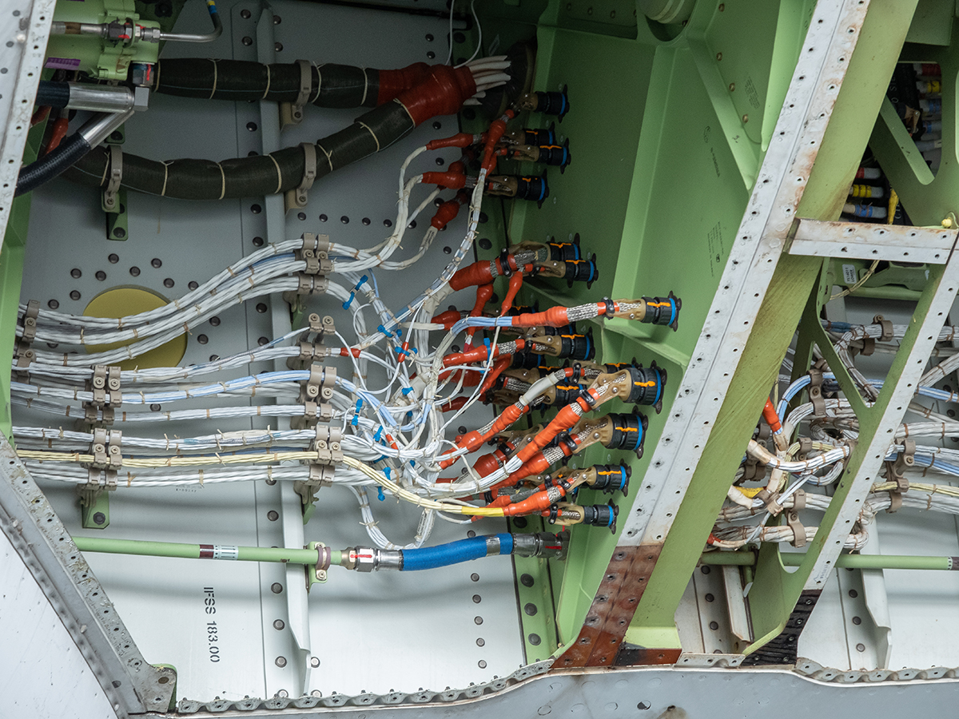
Strain Relief

Slide 38
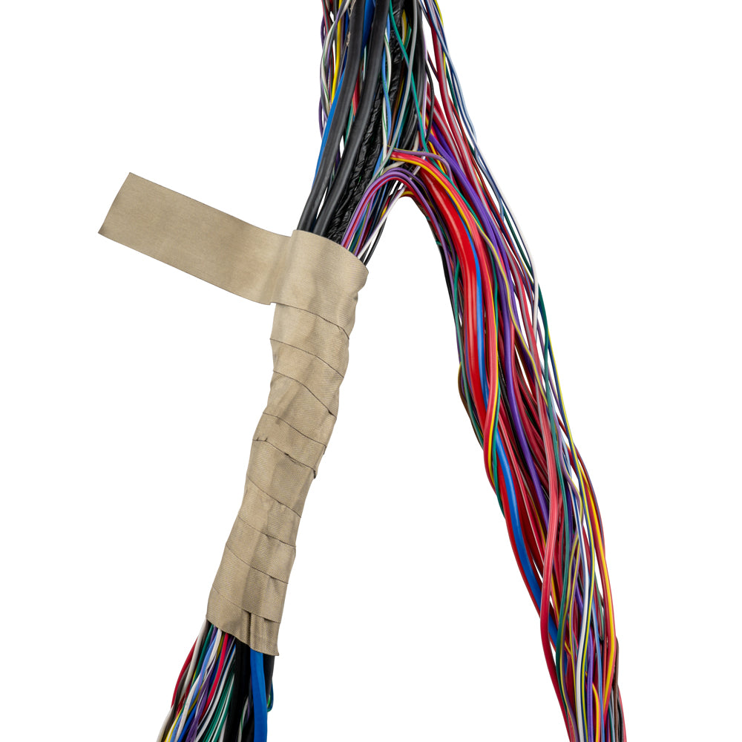
Strain Relief

Slide 39
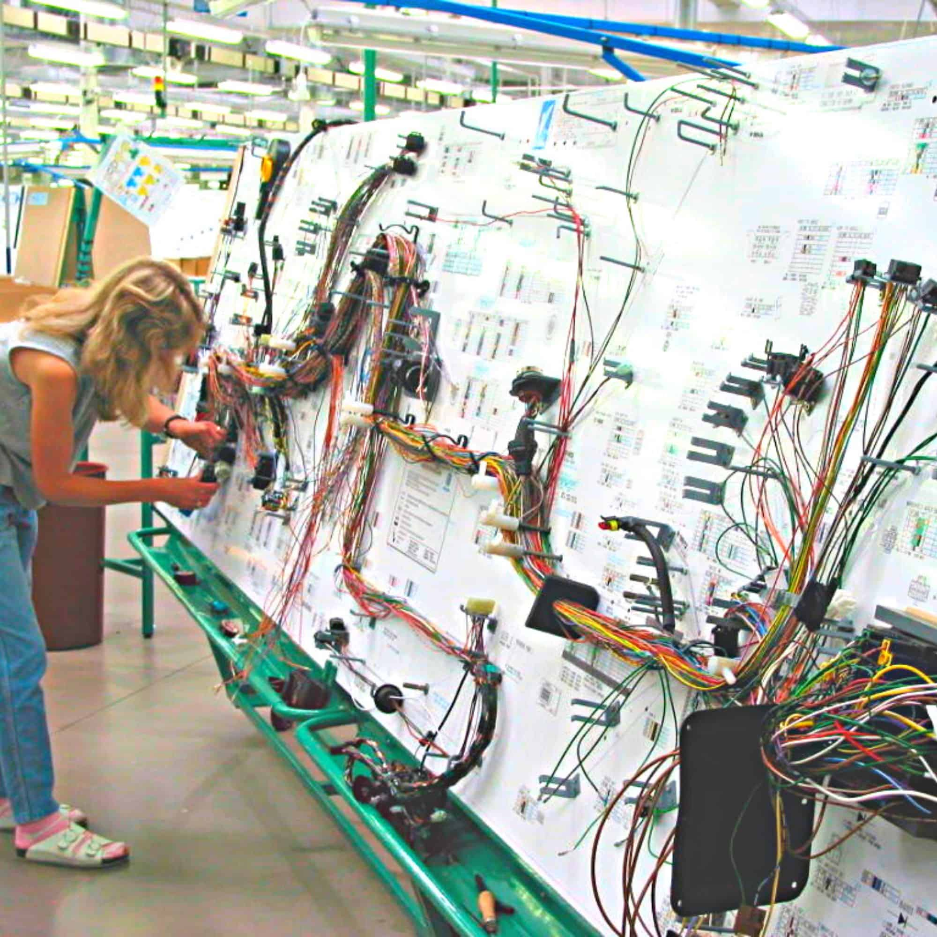
Strain Relief

Slide 40
Advanced Topics – PACTOR Modem
Contact
  Steve Jensen
  ke7gxc@gmail.com

