Slide 1

CARES Monthly Meeting
Steve Jensen KE7GXC
Emergency Coordinator
Clackamas County
CARES-EC@clackamasares.org
May-2026
Notes:
Steve Jensen – KE7GXC - EC Clackamas County ARES

Slide 2
CARES Monthly Meeting
Technology:
Join the "ClackamasARES" and CARESTech groups in groups.io
    ClackamasARES@groups.io
    CAREStech@groups.io
Participate !
  CARES tech zoom call Tuesdays @ 4pm
Notes:
Steve Jensen – KE7GXC - EC Clackamas County ARES

Slide 3
CARES Monthly Meeting
CARES website: www.ClackamasARES.org
  Please check it periodically for news items, etc.
Notes:
Steve Jensen – KE7GXC - EC Clackamas County ARES

Slide 4
CARES Monthly Meeting
Batteries to the “recycler”
    Northwest Battery Supply / Battery XChange - 39th & Belmont)
  1770 lbs @ 0.16 = $283
      (25 big batteries & a bunch of small ones)
  The biggest load I've ever taken to them!
  Thanks to Mitch and Jeremy for all their help!
Notes:
Steve Jensen – KE7GXC - EC Clackamas County ARES

Slide 5
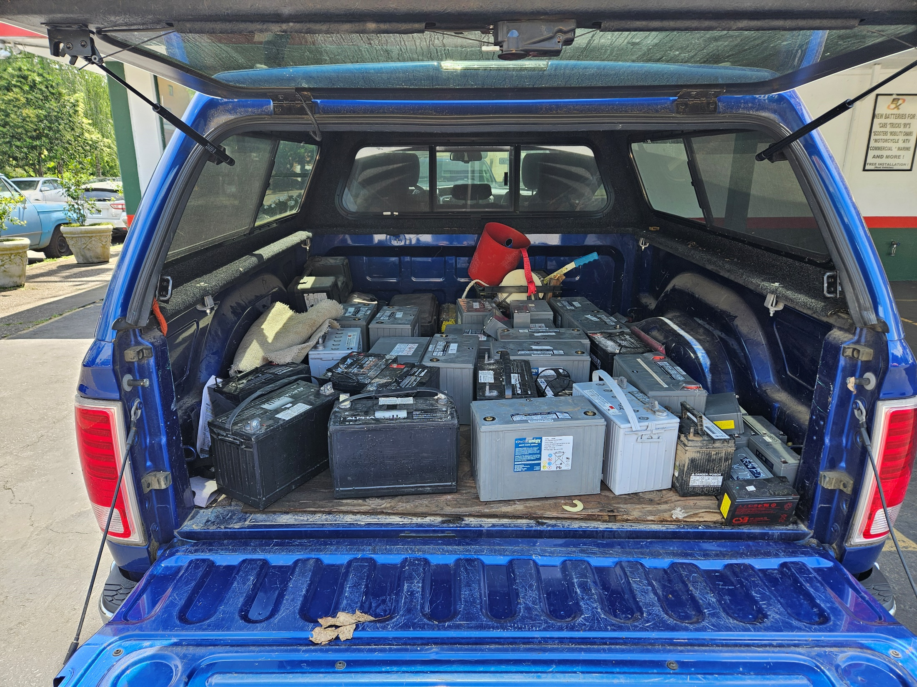
CARES Monthly Meeting
Notes:
Steve Jensen – KE7GXC - EC Clackamas County ARES

Slide 6
CARES Monthly Meeting
Batteries to the “recycler”
    “Aging out” -- old Gel and AGM ☺
    Recommend LiFePO4 – Lithium Iron Phosphate
Continue to recycle the Gel & AGM’s
Notes:
Steve Jensen – KE7GXC - EC Clackamas County ARES

Slide 7
CARES Monthly Meeting
Questions?
Notes:
Steve Jensen – KE7GXC - EC Clackamas County ARES

Slide 8
CARES Monthly Meeting
Linksys routers --- predecessors to AREDN
  HSMM software (re: 12-Feb-2016)
  This technology has served well
  It is time to retire it – send the units to recycle
Notes:
Steve Jensen – KE7GXC - EC Clackamas County ARES

Slide 9
CARES Monthly Meeting
Time reporting
Hopefully the following clarifies the requirements
Notes:
Steve Jensen – KE7GXC - EC Clackamas County ARES

Slide 10
CARES Monthly Meeting
I publish two participation time reports each month
One for CCDM
One for Oregon state ARES / ARRL leadership
Notes:
Steve Jensen – KE7GXC - EC Clackamas County ARES

Slide 11
CARES Monthly Meeting
Monthly CCDM report contains
  The number of participants in CARES, percentage ICS trained participants and total TIME in three categories:
    SET's / Exercises hours: ###
    Training hours: ###
    Other hours: ###
    Total hours: ###
Notes:
Steve Jensen – KE7GXC - EC Clackamas County ARES

Slide 12
CARES Monthly Meeting
Reports for state ARES & ARRL requires:
  Total number of nets & hours
  Total number of public service events & hours
  Total number of training sessions & hours
  Total Participants:
  Total Person Time in hours:
  and a bunch of related -----
I derive these from the weekly net and activity reports you submit
Notes:
Steve Jensen – KE7GXC - EC Clackamas County ARES

Slide 13
CARES Monthly Meeting
Some have asked about under-reporting and over-reporting of hours.....
I manage the reported numbers using a spreadsheet
Fingers – crossed :-)
Notes:
Steve Jensen – KE7GXC - EC Clackamas County ARES

Slide 14
CARES Monthly Meeting
Questions?
Notes:
Steve Jensen – KE7GXC - EC Clackamas County ARES

Slide 15
CARES Monthly Meeting
Upcoming ODART:
Aeronautical mobile Winlink RMS for ODART
--- demonstration project ---
Contact: Arnie W7CRI – AEC West
Notes:
Steve Jensen – KE7GXC - EC Clackamas County ARES

Slide 16
CARES Monthly Meeting
ORRC coordination of CARES repeaters:
    Ongoing efforts ---
    CLAC 7 Highland Butte KD7ZDO 441.900
    CLAC 8 Crutcher Bench KD7ZDO 440.125
    CLAC 11 KD7ZDO 146.800
    OC 1 Boynton W7ZRS 442.075
    Suncrest West Linn (FM voice, Winlink & link to LO 1) under construction
Notes:
Steve Jensen – KE7GXC - EC Clackamas County ARES

Slide 17
CARES Monthly Meeting
Highland Butte (other repeater)
Kirk -- K1RKS
444.050 MHz, Pl 100
Will link to the 145.29 repeater for the
    10am tech net M-F
    7pm nets M-Sat
Notes:
Steve Jensen – KE7GXC - EC Clackamas County ARES

Slide 18
CARES Monthly Meeting
CCDM badges
upcoming renewals -- deferred until 01-July
Notes:
Steve Jensen – KE7GXC - EC Clackamas County ARES

Slide 19
CARES Monthly Meeting
Questions?
Notes:
Steve Jensen – KE7GXC - EC Clackamas County ARES

Slide 20
CARES Monthly Meeting
Reminders:
  Orange kits maintenance
  Generator & lighting kits maintenance
Notes:
Steve Jensen – KE7GXC - EC Clackamas County ARES

Slide 21
CARES Monthly Meeting
Providence Milwaukie Hospital (PMH) - AREDN
  Don W7HDM, Al KI7ATP and I installed AREDN equipment on the roof.
  Next up is the link into the ham radio room at PMH
  The HF antenna rework ---
Notes:
Steve Jensen – KE7GXC - EC Clackamas County ARES

Slide 22
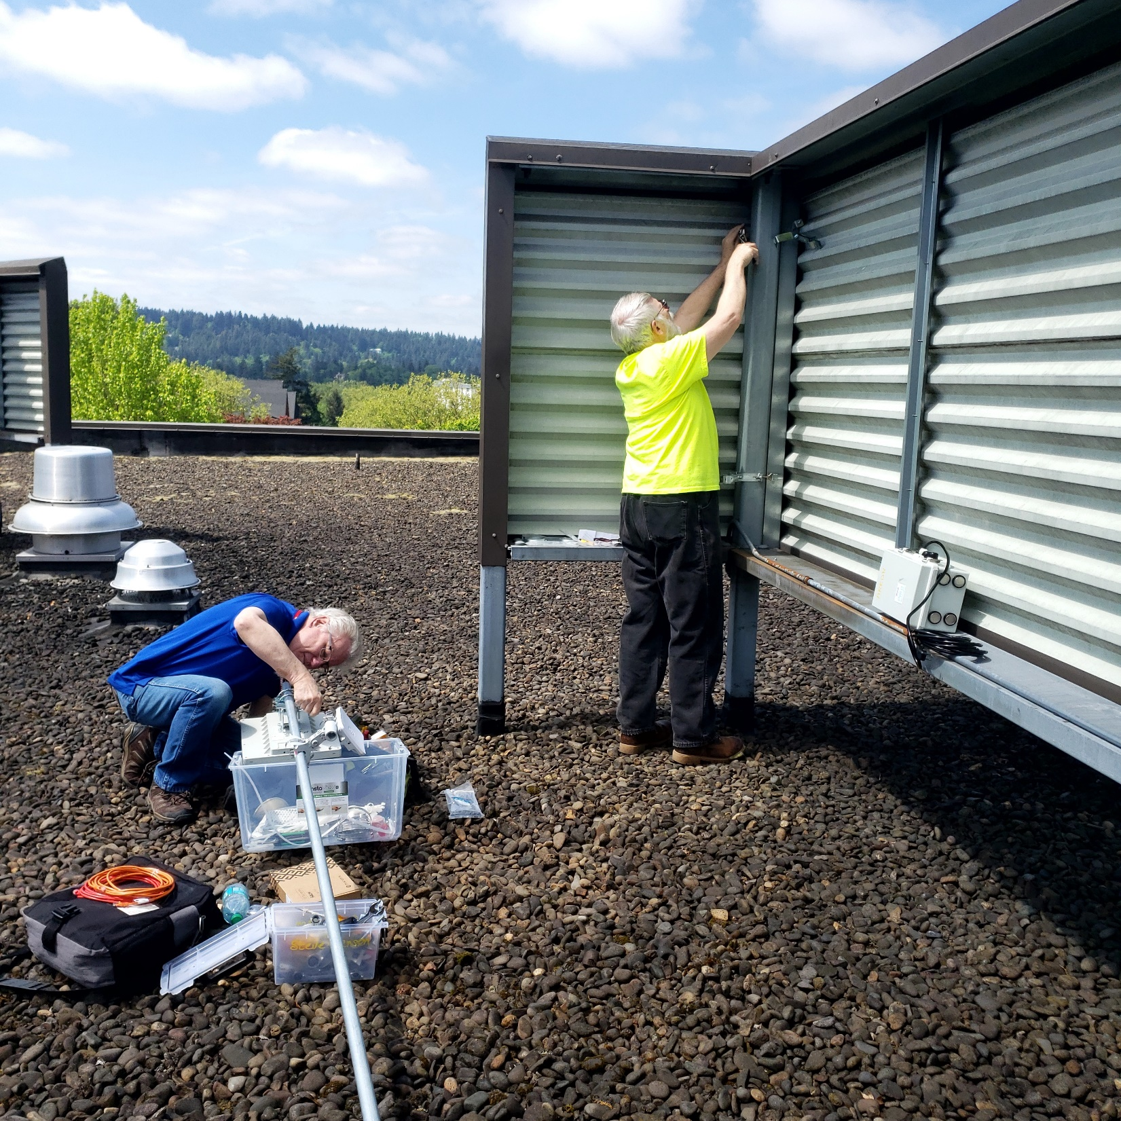
CARES Monthly Meeting
Notes:
Steve Jensen – KE7GXC - EC Clackamas County ARES

Slide 23
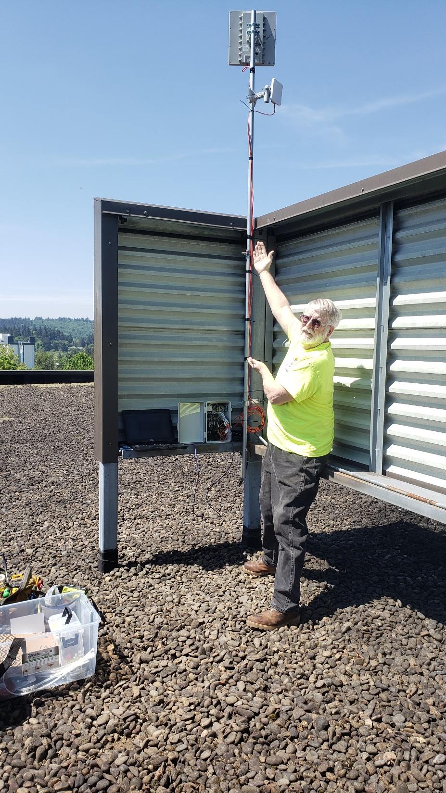
Notes:
Steve Jensen – KE7GXC - EC Clackamas County ARES

Slide 24
CARES Monthly Meeting
Oregon City Teddy Bear Parade 2026
  Thanks to everyone who participated !
Notes:
Steve Jensen – KE7GXC - EC Clackamas County ARES

Slide 25
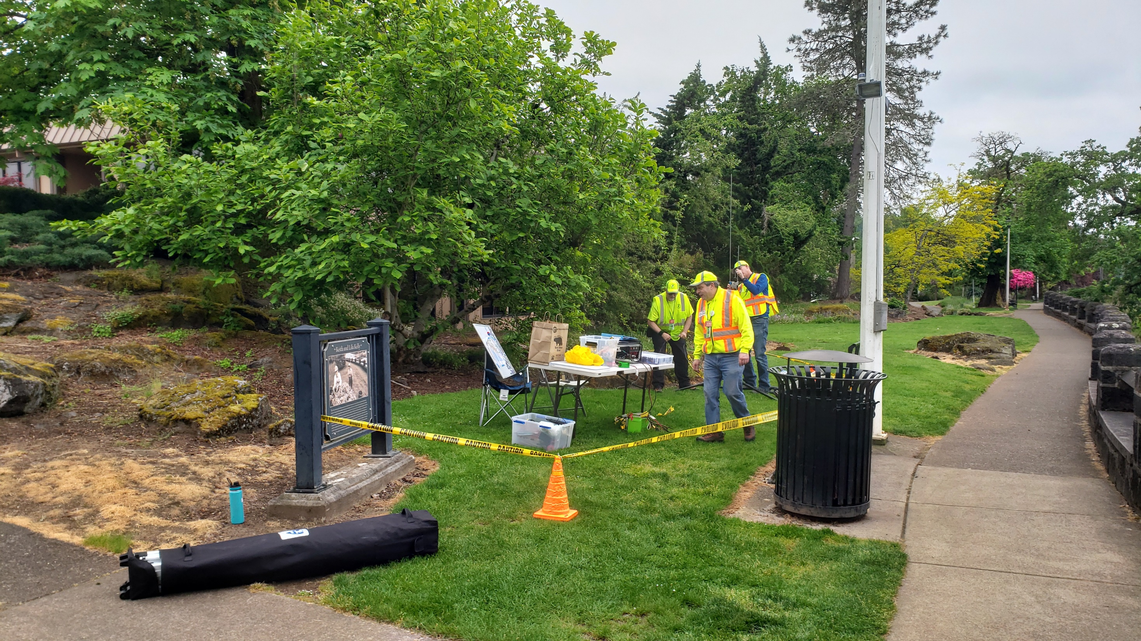
CARES Monthly Meeting
Oregon City Teddy Bear Parade 2026
Notes:
Steve Jensen – KE7GXC - EC Clackamas County ARES

Slide 26
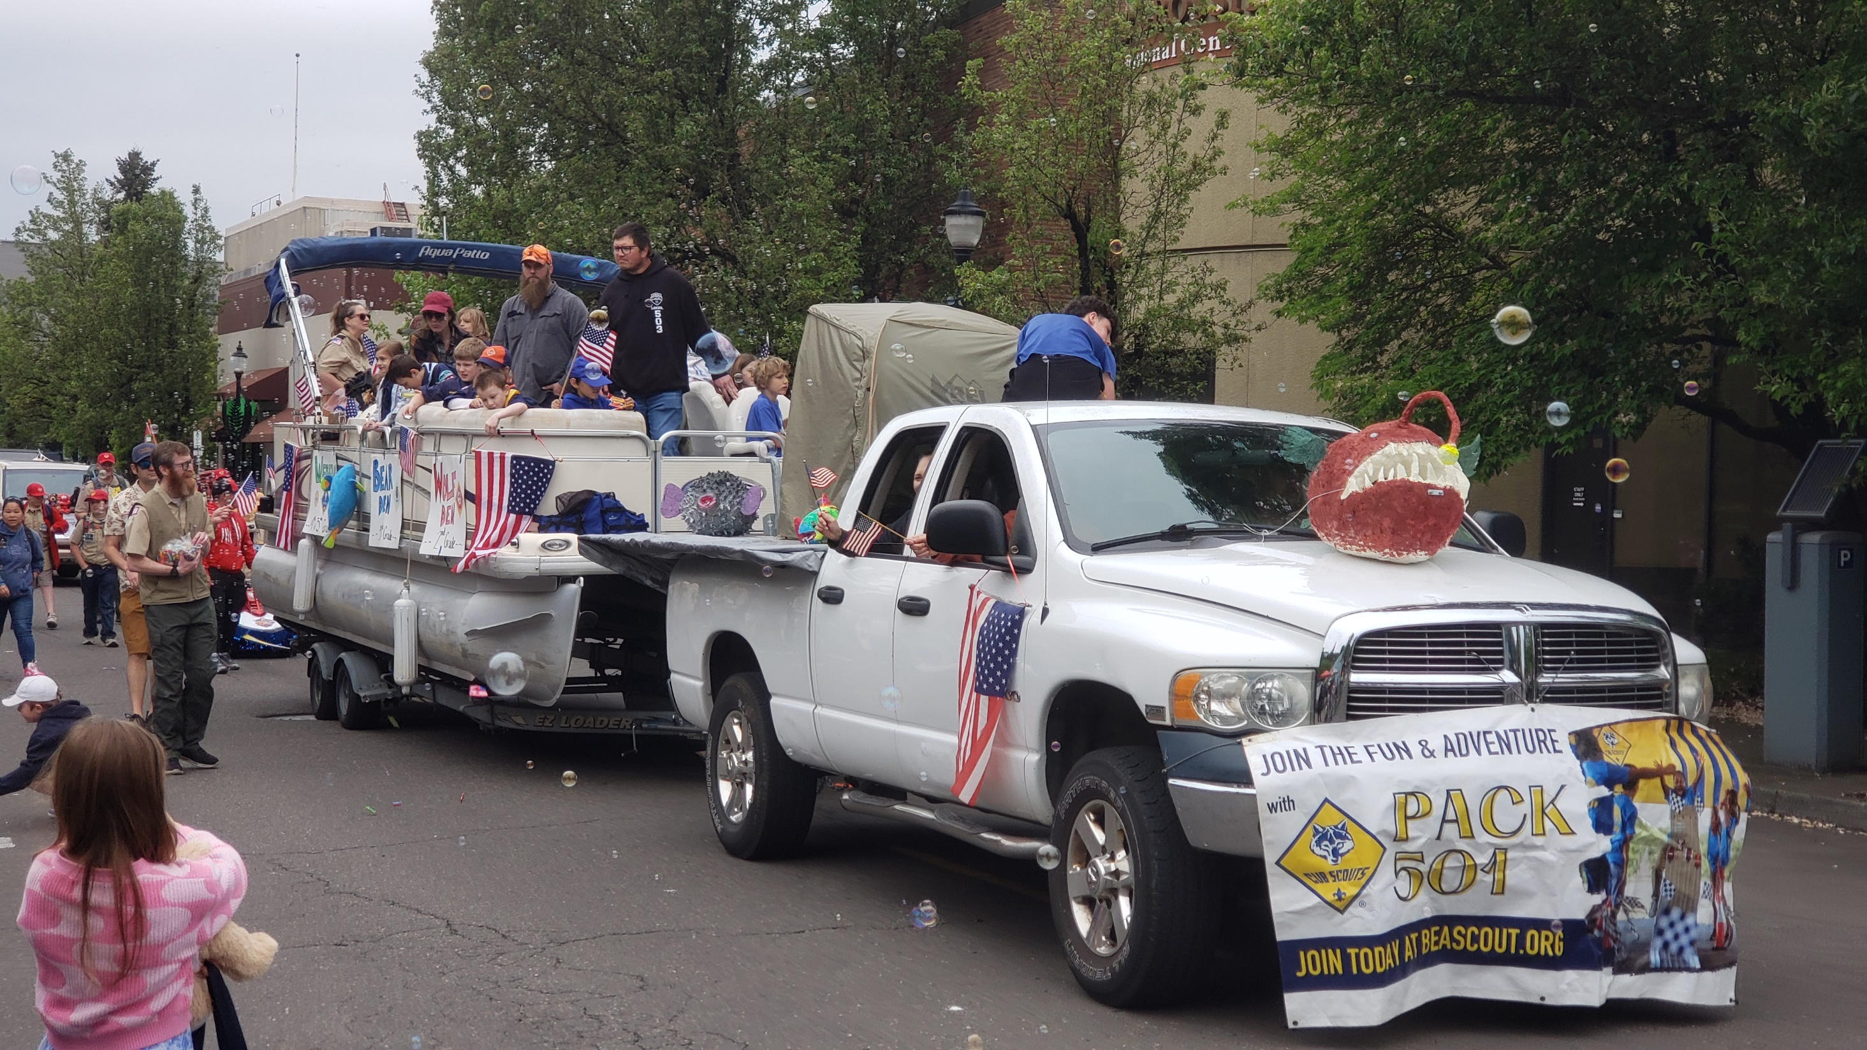
CARES Monthly Meeting
Oregon City Teddy Bear Parade 2026
Notes:
Steve Jensen – KE7GXC - EC Clackamas County ARES

Slide 27
CARES Monthly Meeting
CCDM Mt Hood Great Escape
  Thursday & Friday (7th & 8^{th)} of last week
  Thanks to everyone who participated !
  Be sure to send your ICS-309’s to Jeremy by the 18th
  First set of pictures are Sandy, the second set are Wilsonville
Notes:
Steve Jensen – KE7GXC - EC Clackamas County ARES

Slide 28
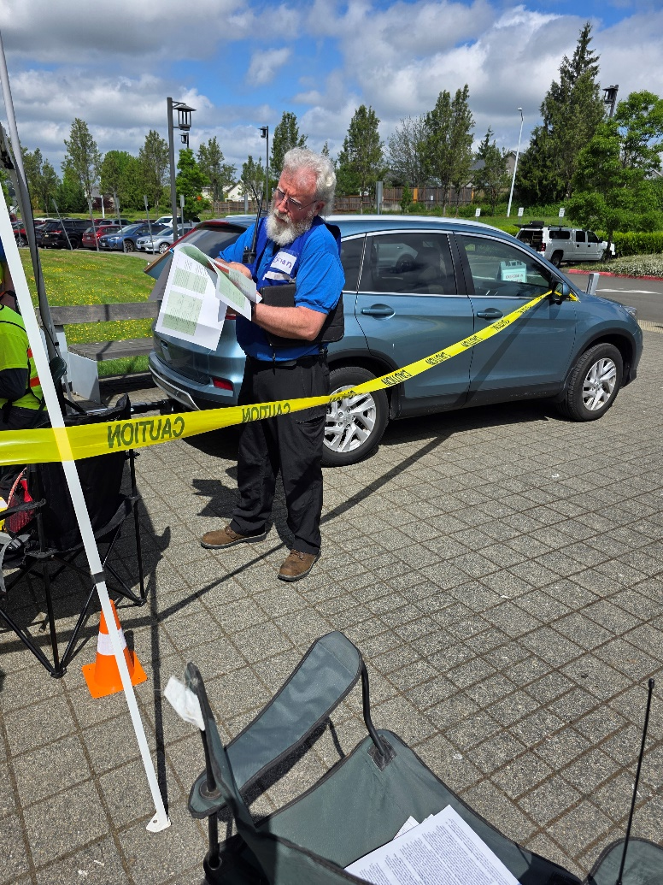
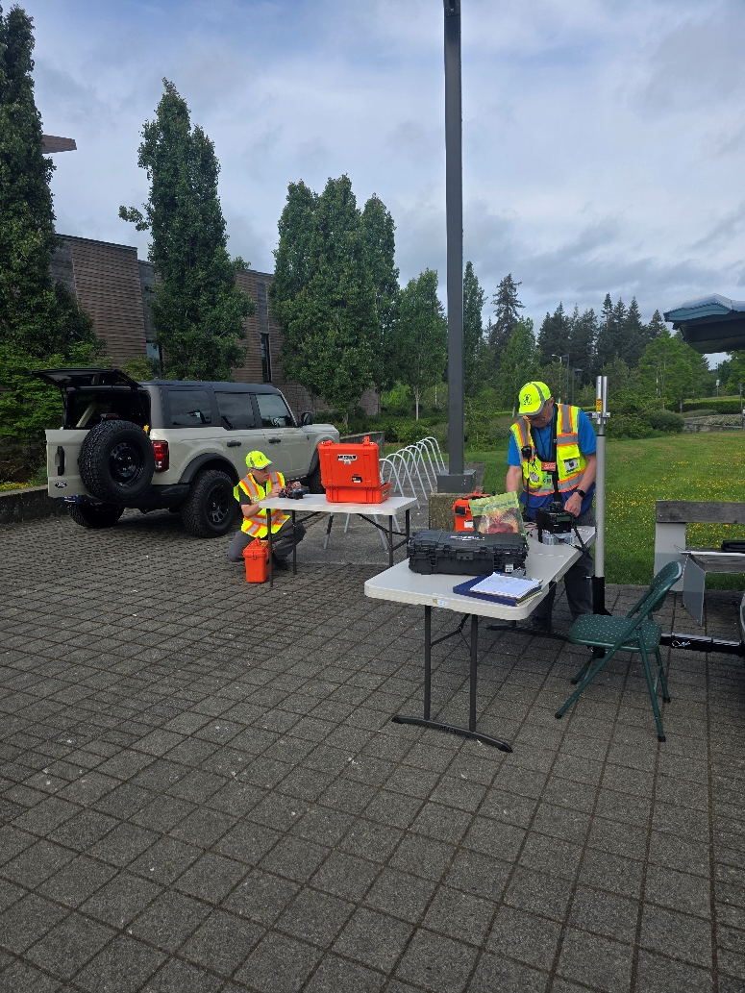
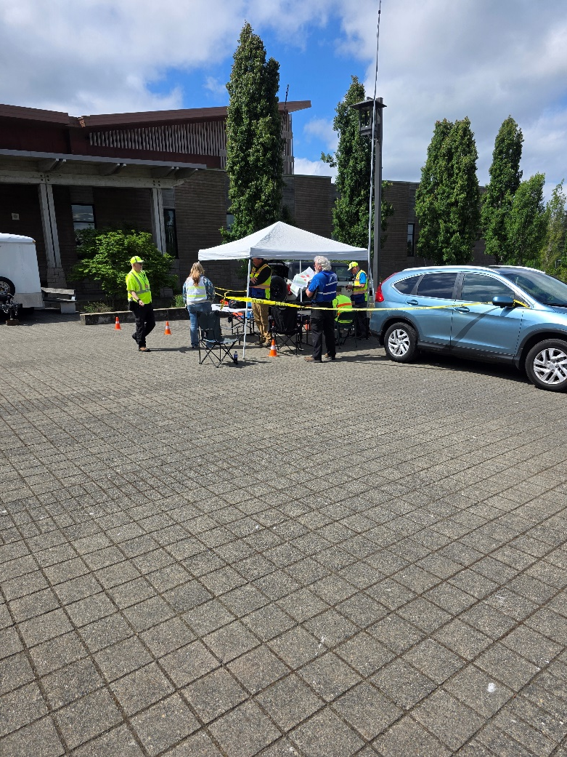
Sandy HS site
Notes:
Steve Jensen – KE7GXC - EC Clackamas County ARES

Slide 29
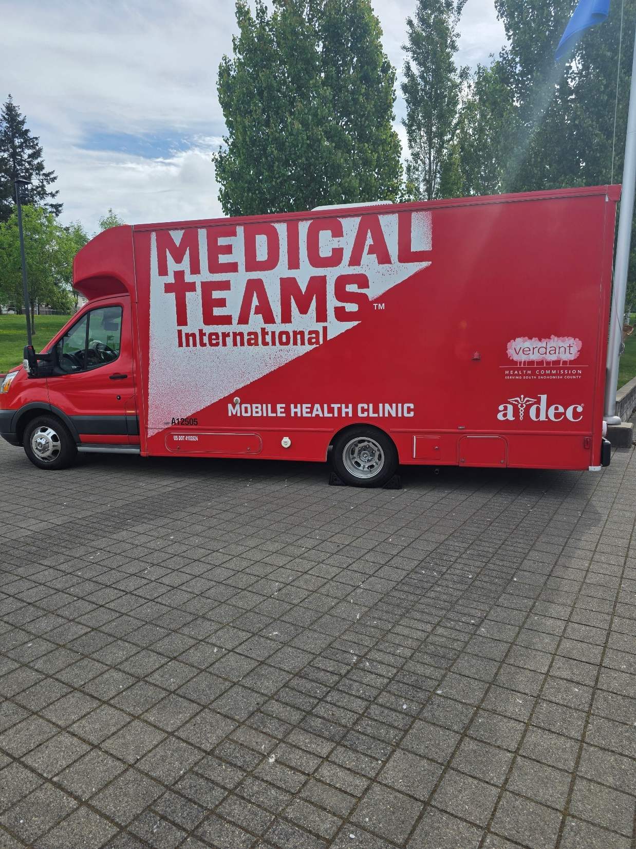
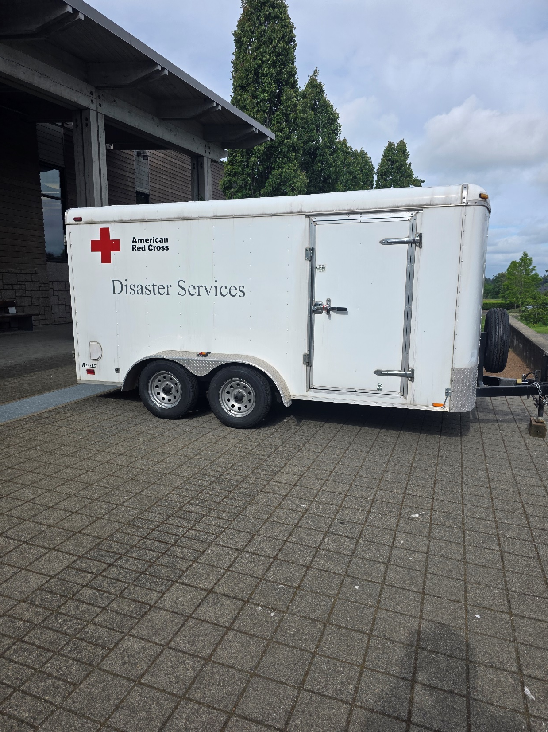
Notes:
Steve Jensen – KE7GXC - EC Clackamas County ARES

Slide 30
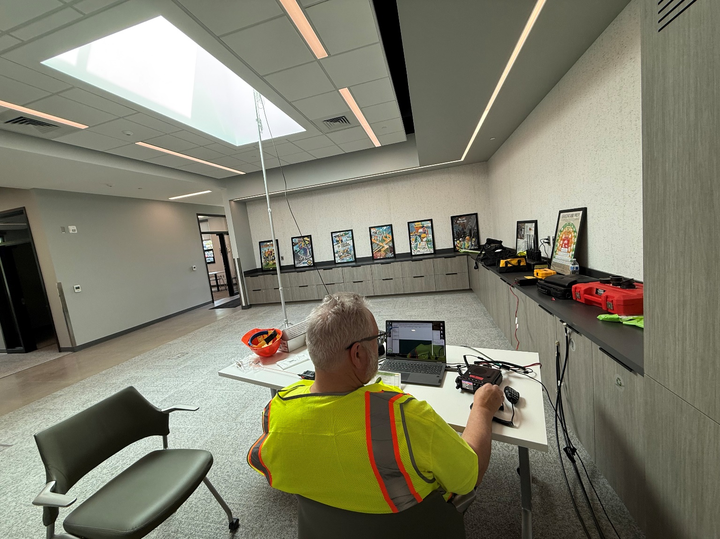
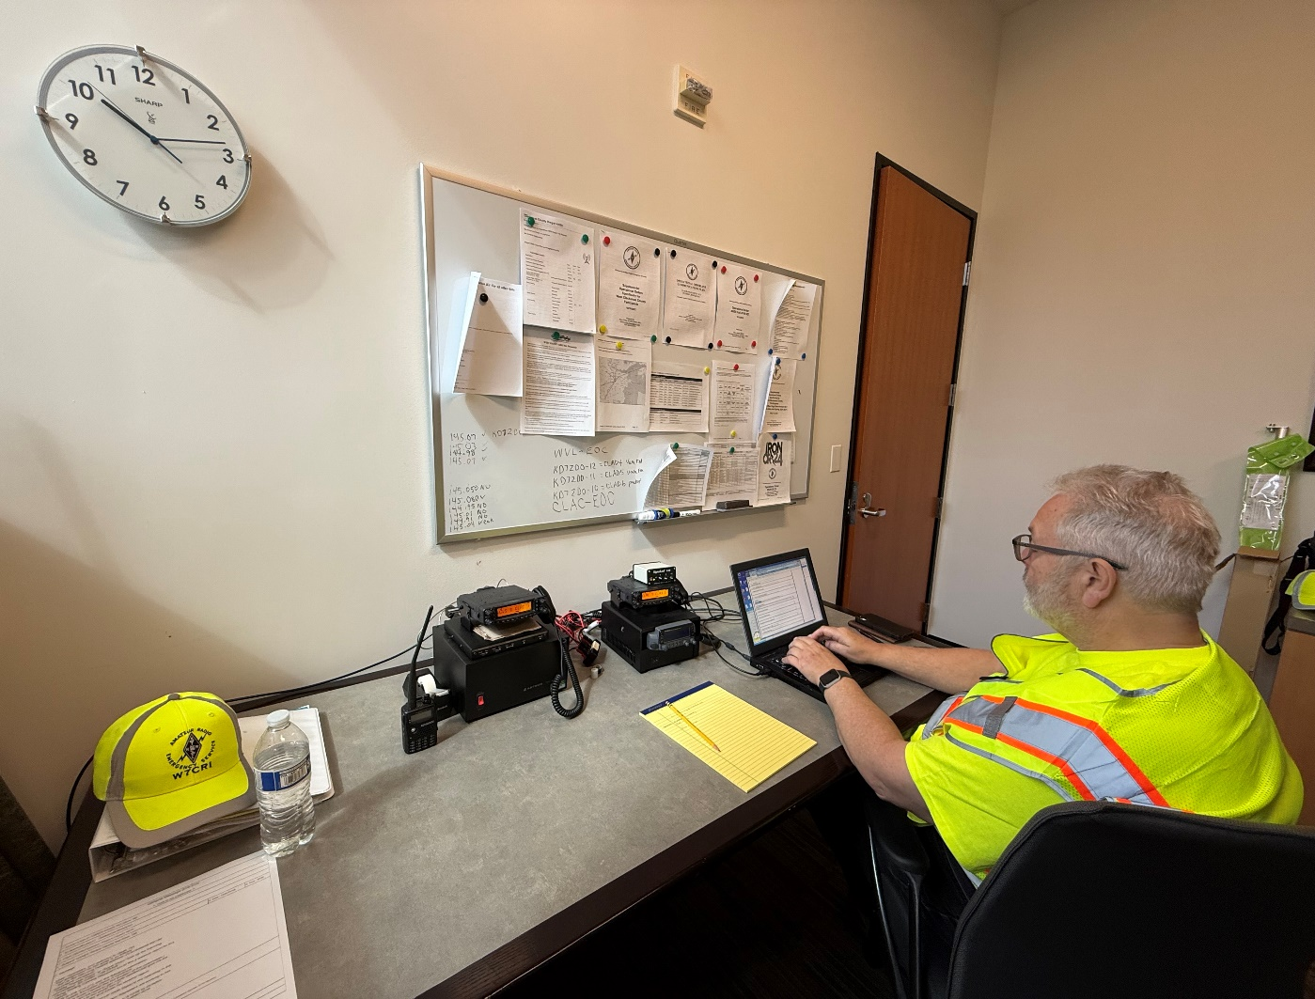
Wilsonville site
Notes:
Steve Jensen – KE7GXC - EC Clackamas County ARES

Slide 31
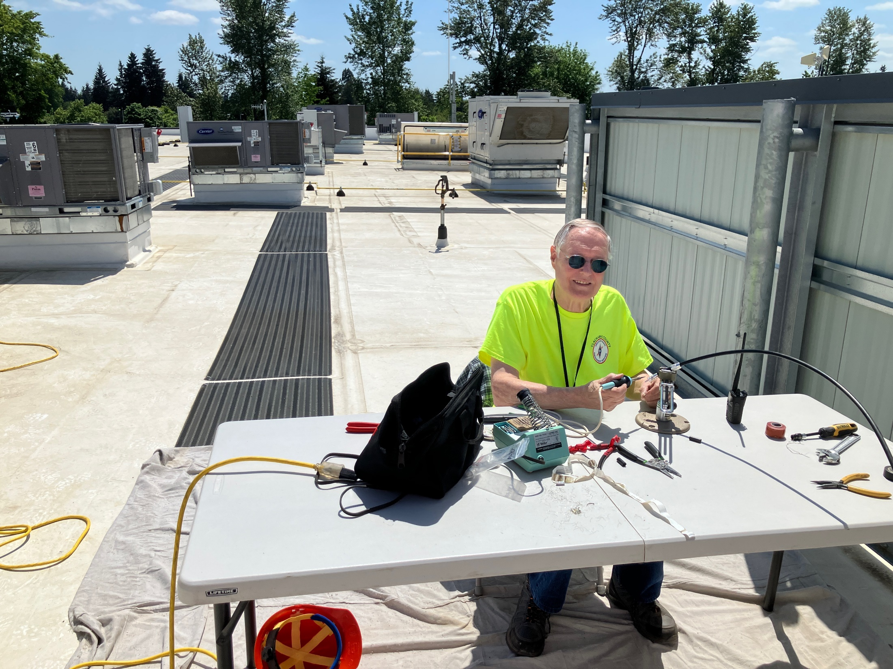
Notes:
Steve Jensen – KE7GXC - EC Clackamas County ARES

Slide 32
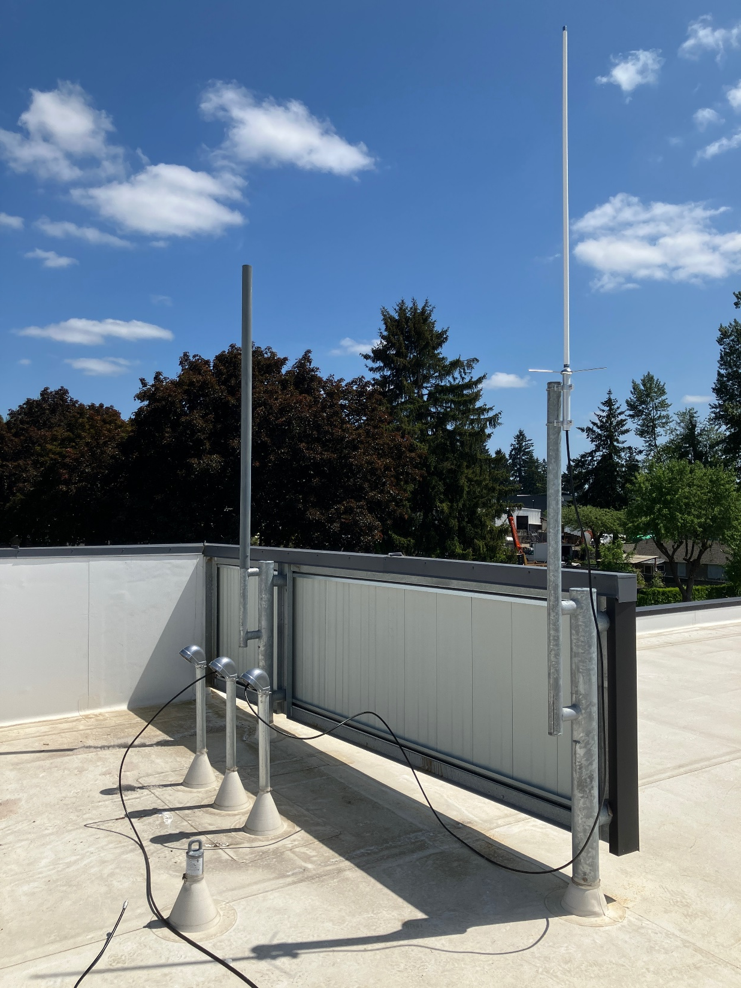
Notes:
Steve Jensen – KE7GXC - EC Clackamas County ARES

Slide 33
CARES Monthly Meeting
Mount Hood Great Escape
Aaron CCDM
Notes:
Steve Jensen – KE7GXC - EC Clackamas County ARES

Slide 34
CARES Monthly Meeting
Questions?
Other announcements?
Steve Jensen – KE7GXC
EC Clackamas County ARES
CARES-EC@clackamasares.org
Notes:
Steve Jensen – KE7GXC - EC Clackamas County ARES

Slide 35
CARES Monthly Meeting
Tonight:
  UTM Presentation
  Allen N7YAF
Notes:
Steve Jensen – KE7GXC - EC Clackamas County ARES

